Slide 1

Made in America, Again
April 12, 2013
Biennale Piccola Industria Confindustria 2013

Slide 2

The map of the world changed at a geological pace

Slide 3
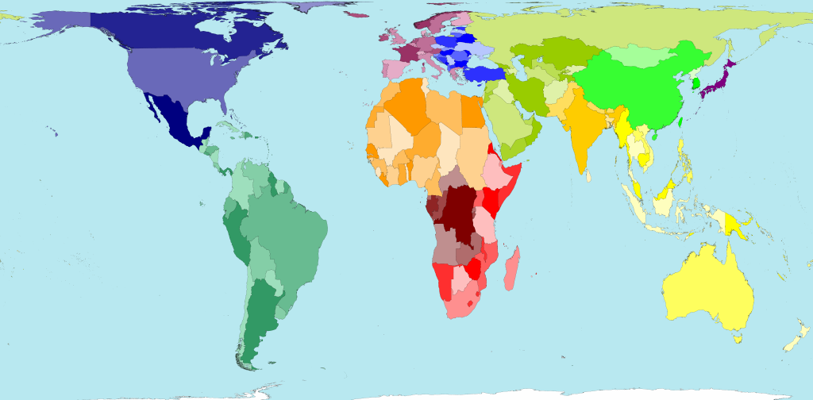
Physical map of the world

Slide 4
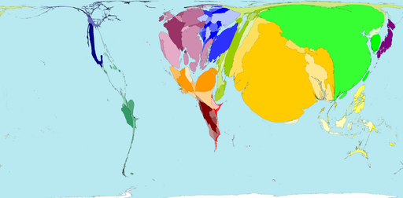
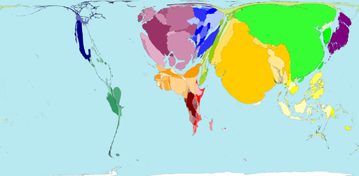
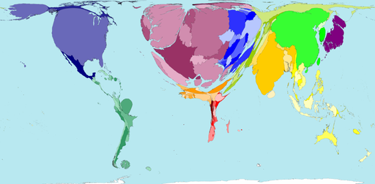
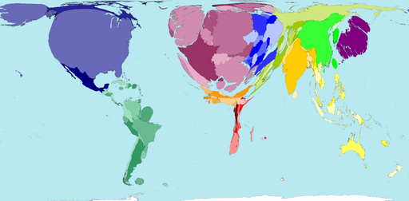
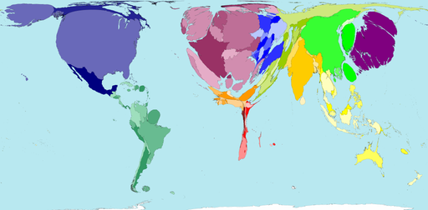
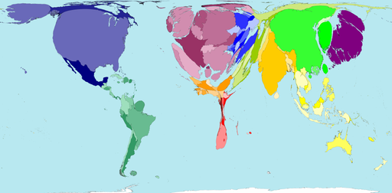
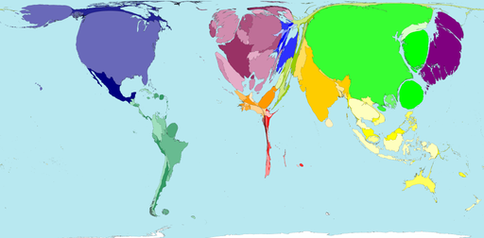
Humans have created an economic map
Relative world economics
1 AD
Relative world economics
1500 AD
Relative world economics
1900 AD
Relative world economics
1960 AD
Relative world economics
1990 AD
Relative world economics
2002 AD
Relative world economics
2020 AD

Slide 5


Slide 6









Slide 7



Slide 8



In Glen Burnie, Maryland

Slide 9
US gains in manufacturing output enabled by sustained increases in productivity
US manufacturing output versus US manufacturing employment versus US manufacturing productivity
400
Employment index (1972 = 100)
1
Manufacturing output index (1972 = 100)
300
Output up
~ 2.5 × since 1972
200
100
Labor down to
0.7 × 1972 levels
0
72
74
76
78
80
82
84
86
88
90
92
94
96
98
00
02
04
06
08
10
11
1. Gross value of final products, measured in 2005 USD prices, Federal Reserve data
Source: Federal Reserve; US Bureau of Labor Statistics

Slide 10
US projected to maintain significant productivity advantages versus other manufacturing countries
Manufacturing productivity per worker
Historical CAGR
Real productivity (2010 USD)
120,000
2000–2010
USA
1.9%
100,000
25%
33%
Germany
1.6%
80,000
Japan
2.3%
60,000
40,000
China
9.6%
20,000
0
2000
2001
2002
2003
2004
2005
2006
2007
2008
2009
2010
Source: EIU; BLS; ILO; BCG analysis

Slide 11


Slide 13
A moving target: selected production clusters in China
Chemicals
Dalian, Shenyang, Nanjing, Yangzhou, Suzhou, Shanghai, Hangzhou, Shaoxing , Wenzhou, Jiangmen, Tianjin
Textiles
Nanjing, Yangzhou, Suzhou, Hangzhou, Ningbo, Shaoxing, Shenzhen, Zhongshan, Jiangmen, Foshan , Dongguan
Shoes
Shenyang, Shanghai, Hangzhou, Ningbo, Wenzhou, Zhongshan, Foshan
Furniture
Shenyang, Shaoxing , Shenzhen, Zhongshan, Foshan , Dongguan
Computers
Shenzhen, Jiangmen, Dongguan

Slide 14
But the US currently makes ~ 75% of the manufactured goods it consumes, maintaining a robust manufacturing base
% of US manufactured goods consumed in 2009¹ by source
100
Made
in:
80
China
60
Other
low-cost
countries
40
Rest of
the
world
20
Net US²
0
Food and beverages
Petroleum and coal
Fabricated
metals
Plastics and
rubber
Chemicals
Primary
metal
Transportation
goods
Machinery
Computers
and
electronics
Apparel,
footwear, and
accessories
Wood products
Paper
products
Glass, stone,
and minerals
Furniture
Textiles
and fabrics
Appliances &
electrical equipment
Miscellaneous
Value of US manufactured goods consumed by category (B$)
1. Goods consumed = production (value of final and intermediate goods) + imports (CIF basis) -exports (CIF basis) 2. Net US = production (value of final and intermediate goods) -exports
Source: National Census Bureau; BEA; BCG analysis

Slide 15
Increasing labor costs and rising Yuan combining to drive rapid increase in China's average labor rates versus the US
Average Chinese manufacturing wages for ~ 100M workers² growing faster than US' ...
... and the Yuan appreciating against the dollar ...
... which is offsetting Chinese productivity gains
USD
RMB
USD : RMB
China : US productivity (%)
30
160
0.18
3%
50
+3%
0.17
+4%
0.16
4%
40
7%
120
0.15
20
+2%
0.14
1%
0.13
30
7%
80
0.12
0.11
8%
0.10
20
10
0.09
+14%
40
0.08
10
+9%
+14%
0.07
0.06
0
0
0.05
0
2000
2005
2010
2015
2000
2005
2010
2015
2000
2005
2010
2015
US (USD)
China (RMB)¹
Yuan to dollar
1. Hourly compensation based on BLS special studies data; an additional compensation premium of 14% added to account for recent labor market trends and TVE data bias; it should be noted that this figure data may-be subject to some double counting due to the BLS methodology for benefits calculations 2. Most recent data point is 2008, from 2011 BLS report; combined with World Bank data, this makes up ~ 13% of the Chinese labor force
Source: EIU; BLS; selected company data; BCG analysis

Slide 16
US projected to maintain significant productivity advantages versus both Europe and China
Manufacturing productivity per worker
Historical CAGR
Projected CAGR
Real productivity (
2010
USD)
2000–10
2010–15
US
1.9%
1.1%
120,000
~ 3.4 ×
~ 2.5 ×
~ 5 ×
90,000
Europe
1.7%
1.0%
~ 4 ×
~ 2.6 ×
~ 1.9 ×
60,000
China
9.6%
8.4%
30,000
0
US to China
2000
2001
2003
2005
2007
2009
2011
2013
2015
Europe to China
1. Europe includes Germany, France, UK, Italy, Czech Republic, and Poland
Source: EIU; BLS; ILO; BCG analysis
Notes:
Productivity rankings for later slide
2006:
1. Slovakia
2. Ireland (driven by focus on production of high-value add goods, e.g., medical products, electronics)
3. Norway
4. Sweden
5. Switzerland
6. Austria
7. Finland
8. United States
Average for country's since 2000 (some averages are only through 2004 or 2005, but most countries have data through 2006)
1. Slovakia
2. Ireland
3. United States
4. Switzerland
5. Austria
6. Sweden
7. Finland
8. Norway
Change in US' ranking is driven by other countries increasing much faster than US since 2006

Slide 17
Rapidly changing economics of Chinese production
2000A
2005A
2010A
2015F
YRD wages ($/hour)
0.72
1.16
2.79
6.31
US new factory ($)
15.81
17.87
21.25
24.81
US/China YRD
22.0 ×
15.0 ×
7.6 ×
3.9 ×
US/China YRD production
3.80
3.70
3.10
2.40
Production adjusted wages
for YRD production ($)
2.77
4.30
8.72
15.02
YRD effective wages as
% of US
17.50
24.00
41.00
61.00

Slide 18
Economics will drive reinvestment in US
Imagine a company ...
... with the following location choices
 | 2000 | 2015F
Wage rate ($/hr) | 15.81 | 24.81
Productivity (%) | 100% | 100%
Labor cost/part ($) | 2.11 | 3.31
Wage rate ($/hr) | 0.72 | 6.31
Productivity (%) | 13%¹ | 42%²
Labor cost/part ($) | 0.74 | 2.00
Labor cost savings (%) | 65% | 39%
Total cost savings (before transportation, duties, and other costs) | 16% | < 10%
US-based auto parts supplier
Most customers are US OEMs that manufacture in the US
Parts take eight minutes of labor on average in the US
Labor represents 1/4 of the total cost of the part
Highly productive workers
Highly automated facilities
Stable wages
US,
likely plant locations
Scarce labor
Rapidly rising wages
Low productivity relative to the US
China, Yangtze River Delta locations
1. Based on average overall Chinese productivity. 2. Average productivity difference between US and China's YRD region. YRD productivity assumed to grow at ~ 7% CAGR over 2009 baseline, slightly slower than overall Chinese manufacturing productivity (~ 8.5%) as other regions adopt more advanced manufacturing practices
Source: EIU; BLS; BCG analysis

Slide 19
Quantitative assessment indicates that seven industry clusters may be close to a tipping point
Remain offshored
May be close to tipping point?
Labor costs as % of total product costs
High
Fabricated metals (6%)
Apparel, footwear, and
accessories (69%)
Furniture (23%)
Glass, stone, and minerals (8%)
Textiles and
fabrics (22%)
Misc. manufactured commodities (31%)
Wood products (4%)
Machinery (12%)
Plastics and rubber (8%)
Appliances and electrical equipment (32%)
Transportation (7%)
Paper products (3%)
US consumption
(% LCC imported)
Computers and
electronics (43%)
Primary metal manufacturing (8%)
Food and beverages (2%)
700B
(13%)
Chemicals (4%)
Petroleum and coal (3%)
Low
Low
Logistics costs as % of product price
High
Remain in US
Note: Included total of 17 NAICS industries. LCC countries include comprises13 countries (Brazil, Cambodia, China, Czech Republic, Hungary, India, Indonesia, Malaysia, Mexico, Poland, Russia, Thailand, and Vietnam). Based on 2010 consumption data
Note: Consumption defined as total production + imports -exports; $1.5T value is real for 2010
Source: US Department of Transportation; US Census Bureau; Bureau of Economic Analysis; BCG analysis

Slide 20



We've seen many clients
Vietnam
Indonesia
Philippines

Slide 21

Mexico

Slide 22

























Many examples of recent decisions by North American companies to rethink their production locations ...
Source: Press search; company websites

Slide 23
The US labor market is the most attractive of all major developed-world manufacturers
Labor costs in other major manuf. economies are
1.3–1.9 times higher than in the US ...
... and the US benefits from a comparatively flexible labor market
2015 productivity-adjusted wages (index, US = 100)¹
Overall labor market regulation rating (max = 10)
200
10
US = 9.0
(5th
ranked)
8.2
8.4
8
150
6
5.9
US = 100
5.3
100
175
4
150
154
127
50
2
0
0
UK
Germany
France
Japan
Germany
France
UK
Japan
World ranking
112
88
62
21
18
Note: Fully loaded wages from EIU. US wages are average for southern states
1. Productivity indexed to US productivity. Projected from 2010–2015
Source: ILO; EIU; 2011 Fraser Institute Economic Freedom ratings; BCG analysis

Slide 24
Abundant natural gas in US has led to a large energy cost advantage for domestic manufacturers
Natural gas prices in other major manufacturing economies are around
2–3.5 times higher than in the US ...
... and industrial electricity prices are
around 1.6–3.7 times higher
Natural gas prices (index, US = 100)
2011 Industrial electricity prices (index, US = 100)
400
300
345
251
300
294
279
207
200
180
191
156
200
100
US =
100
100
US = 100
0
0
UK
Germany
France
Japan
Germany
France
UK
Japan
Note: Energy prices based on 2011 averages
Source: IEA quarterly energy price and tax statistics; BCG analysis

Slide 25
Labor and energy cost advantages will position the US as one of the developed world's lowest-cost countries
Major exporting nation average manufacturing cost structures relative to US (2015 projections)
Manufacturing cost index (US = 100)
140
121
123
120
115
115
108
100
28
36
38
US = 100
100
21
30
93
19
2
2
2
3
4
14
80
2
1
5
6
7
5
4
80
78
3
2
78
77
77
77
74
0
US¹
United Kingdom
Germany
France
Japan
Italy
China²
Labor (productivity-adjusted)
Electricity
Natural gas
Other
1. US figures represent costs in a set of select southern states as defined in prior publications 2. Chinese figures represent Yangtze River Delta region
Note: No difference assumed in "other" costs (e.g., raw materials inputs, machine and tool depreciation, etc); differences in values is a function of the industry mix of each export country; cost structures calculated as a weighted average across all industries
Source: US Economic Census; BLS; BEA; ILO

Slide 26
Productivity-adjusted wages are ~54% higher for Italy than U.S. in 2015
Production worker wages (€/hour)
40
30
28.6
24.5
20
17.1
18.9
18.5
14.4
15.6
10
16.0
0
2000
2005
2010
2015
Italy
US
Note: Fully loaded wages from EIU, US wages are average for Southern states
Source: ILO, EIU; BCG analysis

Slide 27


European and Japanese companies looking to produce in and even export from the US

Slide 28


The European aviation industry is capitalizing on the value of US manufacturing

Slide 29
Estimated reshoring of tipping-point industries and increased exports will result in $100-150 billion of incremental production
Jobs created from repatriation of Chinese imports and increased US exports
Millions of jobs
1
4
1 new US mfg. job creates ~ 3 non-mfg. jobs
1800K
–
2,500K
–
200K
–
2,800K
3,900K
700K
3
2,300K
–
3,200K
2
Indirect
Direct
1
600K
–
1,000K
0
Direct
Indirect
Total
Jobs to Mexico
Jobs to US
1. Bars on graph reflect midpoint of range
Source: BLS; BEA; CIA World Factbook; BCG analysis

Slide 30


Slide 31


Slide 32
Labor and energy cost advantages will position the US as one of the developed world's lowest-cost countries
Major exporting nation average manufacturing cost structures relative to US (2015 projections)
Manufacturing cost index (US = 100)
140
+23%
121
123
120
115
115
100
28
36
38
US = 100
100
30
93
19
14
2
2
3
4
80
2
2
1
6
7
5
4
3
78
77
78
77
77
74
0
China
US
Germany
France
Japan
Italy
Labor (productivity-adjusted)
Electricity
Natural gas
Other
1. US figures represent costs in a set of select southern states as defined in prior publications 2. Chinese figures represent Yangtze River Delta region
Note: No difference assumed in "other" costs (e.g., raw materials inputs, machine and tool depreciation, etc); differences in values is a function of the industry mix of each export country; cost structures calculated as a weighted average across all industries
Source: US Economic Census; BLS; BEA; ILO

Slide 33
Made in America, Again
April 12, 2013
Biennale Piccola Industria Confindustria 2013

