Slide 1
In the Name of Allah

Slide 2
Hormozgan province
Located in the south of Iran
Covers an area of 70, 697 km², facing Oman and UAE.
5 Airports
3 International airports
12 cities,
26 towns,
34 districts and 81 villages
with the population of near 2 million
14 islands,
more than 10 ports,

Slide 3
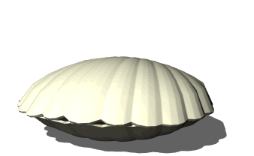
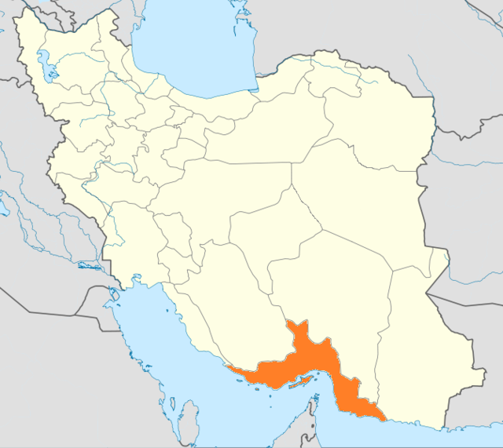
Bandar Abbas the Pearl of Iran

Slide 4
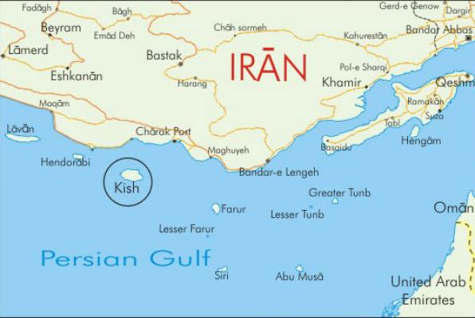
. Has fourteen islands in the Persian Gulf
and 1,000 km of coastline.
. Two main trade free zone islands, Geshm and Kish with international airports.
. The strategic importance of the Persian Gulf further increased after World War I with the discovery of oil in the region
. 30% of Iran's fishery product

Slide 5
Particular attention has been paid to Bandar Abbas as a strategic port and the government invested huge amounts of capital in the infrastructure.
Bandar Abbas serves as a major shipping point, mostly for imports, and has a long history of trade.
Thousands of tourists
Iran Shipbuilding & Offshore Industries Complex Co (ISOICO)

Slide 6
. Biggest port is Iran
. More than 60 percent of import and
export of Iran
. Very high economic level
. Under development and processing
city

Slide 7
. Biggest port is Iran
. More than 60 percent of import and
export of Iran
. Very high economic level
. Under development and processing
city

Slide 8
. And hopefully after iran’s agreement with 5+1 countries, it will be become biggest port in the middle east

Slide 9
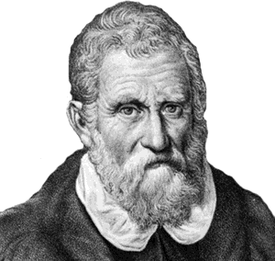
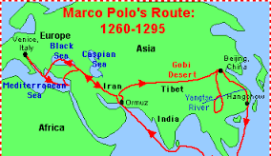
Bandar Abbas and Italian Tourists
Marco Polo
Pietro Della Valle
Marco Polo

Slide 10
Marco Polo's Travels in Persia
Marco Polo visited the port of Bandar Abbas in 1272 and 1293. He reported widespread trading in Persian jewelry, the ivory and silk of Indochina, and pearls from Bahrain in the bazaars in the port of Hormuz.

Slide 11
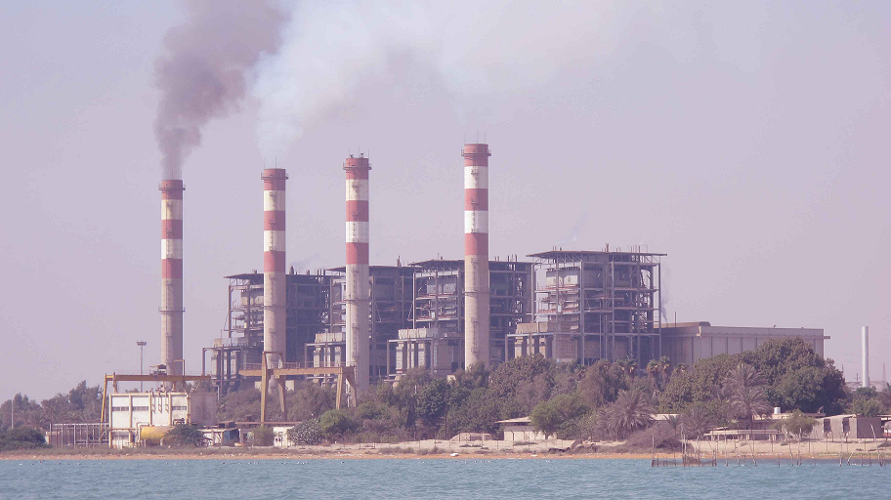
Experience of Italians Contractors in Banar Abbas in last Decade
Shahid Rajaee Port: biggest port in Iran
Power Plant

Slide 12
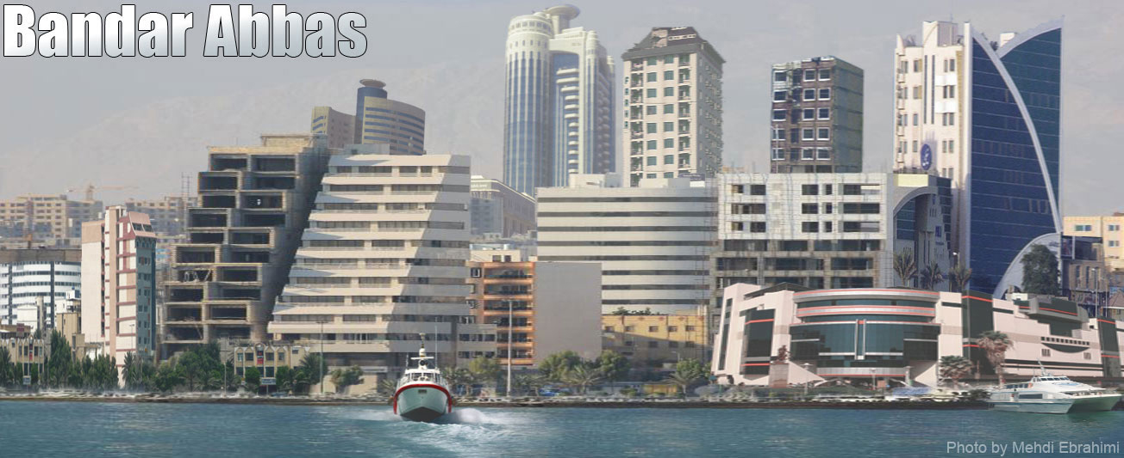
Bandar Abbas Today
The largest & the most important port in Iran and have the most infrastructures

Slide 13
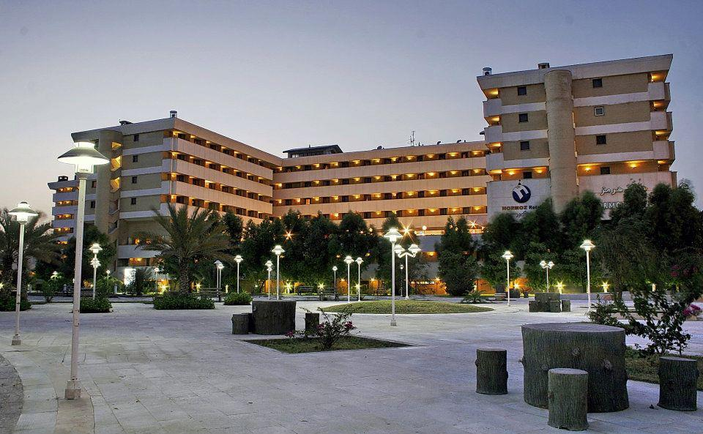
Best hotels
Advanced & traditional fishing industry
Large power plants
Lndustrial towns
Large plants & industries (Aluminum, Steel, Oil & Gas refineries)
The largest commercial, economical, fishery and tourism ports
Vast reserves in sea and land
International airports
Economical free zones

Slide 14
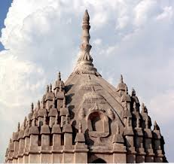
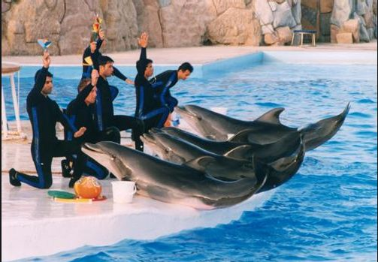
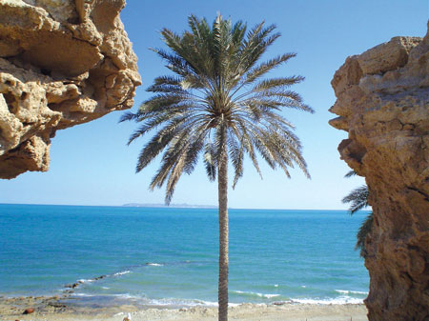
Vast and beautiful beaches
Tourist attractions (islands, natural reserved zones, Geno mineral water spring,
Historical monuments

Slide 15
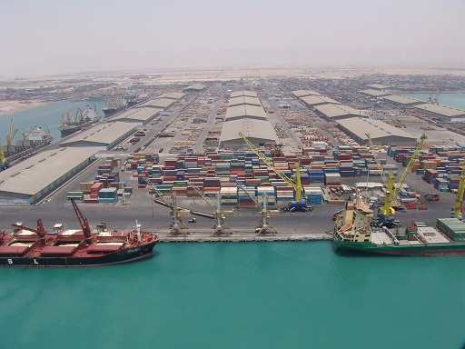
Why Bandar Abbas?
Customs and terminals
Social security
Neighborhood with several countries
Universities and academic centers
Many tourism and shopping centers
Favorable weather in cold seasons
High development potentials
Commercial- economical
Industrial
Transportation ( air, sea & land)
Agriculture

Slide 16
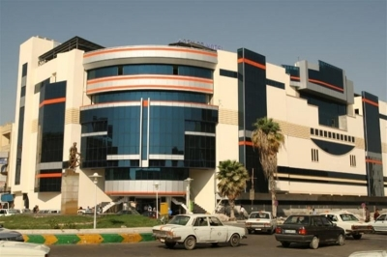
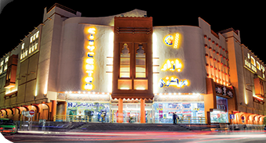
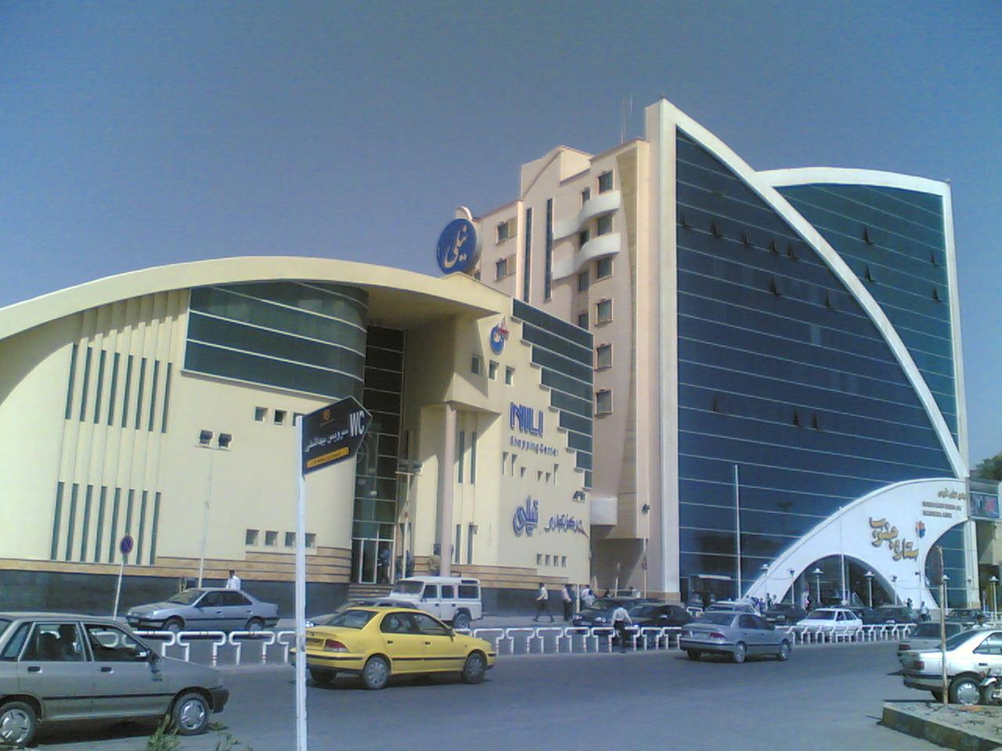
. Hospitality
Multi Cultural
Civilization
Security

Slide 17
Hormozgan University of Medical Sciences
Schools
Medicine
Dentistry
Pharmacy
Nursing & midwifery
Paramedical
Health
International branch
Hormozgan University of Medical Sciences has 1 mean teaching hospital, two educational & specialized hospitals and 13 general hospitals.
Number of beds: 1505

Slide 18
HUMS was founded in 1985 and ……… were graduated in 1993 as physicians.
HUMS has been training MEDICINE since last 30 years, medical sciences including Dentistry, Pharmacy, Nursing, Midwifery, Paramedics and others. Graduates are accepted in residency program to become highly expert board certified surgeons, cardiologists, internists, pediatricians, gynecologists, pathologists, anasthesiologists.

Slide 19
Angiography
MR-angio
4-vessel angio
Angioplasty
CABG
CT angiography
Spiral CT

Slide 20
Bronchoscopy
Colonoscopy
Endoscopy
Nephrostomy
Jejunostomy
LASIK
CHEMOTHERAPY and Organ transplant

Slide 21
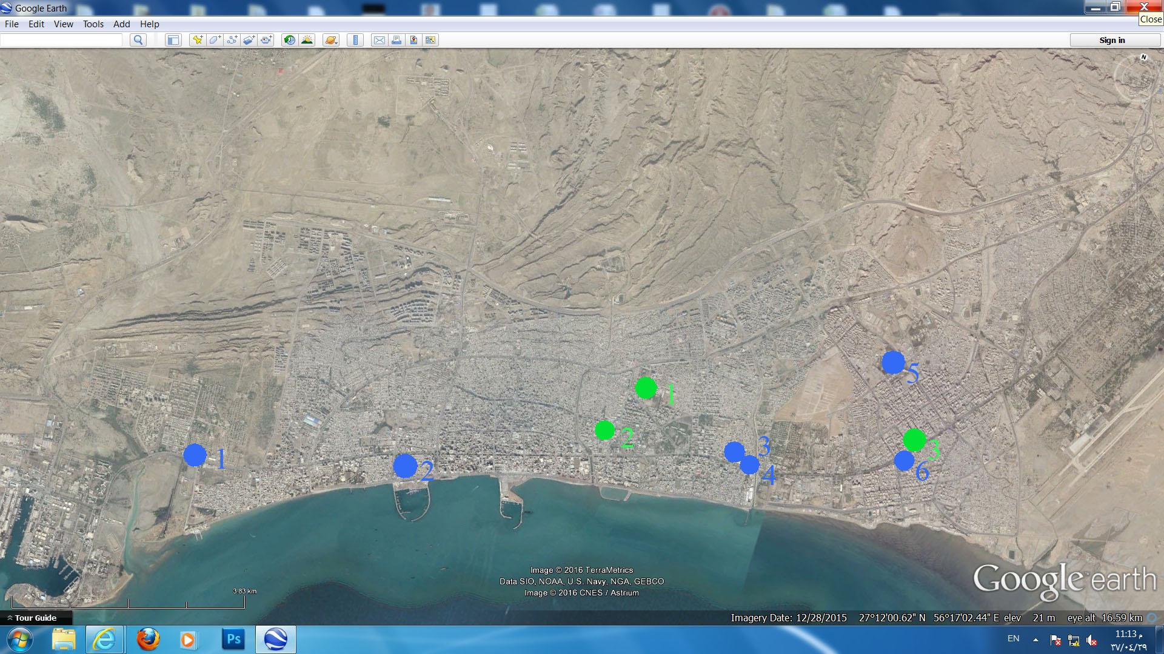
Hospitals & Healthcare Centers in Bandar Abbas
1- Navy Hospital
2- Saheb-a -zaman Hospital
3- Omme Leyla Hospital
4- Emam Reza Hospital
5- Khalije Fars Hospital
6- Khatamol anbia Hospital
1- Shahid Mohammadi Hospital &
Ebne Sina Psychiatric Hospital
2- Shariati Hospital
3- Chidren’s Hospital

Slide 26
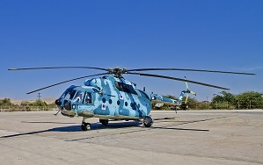
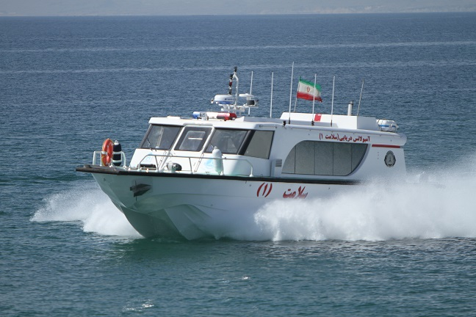
Air Emergency
Sea Emergency

Slide 28
According to Hormozgan
Population,
location,
Tourist and health tourism
HUMS students (medicine, dentist and pharmacy) then Hormozgan province need a big teaching hospital with about 600 modern beds.

Slide 29
Our facilities for new hospital
HUMS has so many lands which is very good location for new hospital.
1- One of our suggestion for new hospital is in the Shaheed Mohammadi hospital which is located in the Bandar Abbas centre. There is about 50,000 m2 free land in this hospital that this belong to HUMS.
2- Second place is 200,000 m2 which is belong to HUMS and had good view in future.

Slide 30
Hormozgan University of Medical Sciences
The Hormozagn province needs a very good and modern hospital with these conditions:
1-Beds: 600
2- Building material must be resistance to humid and warm weather
3- Good and modern hospital with teaching usage
4- Smart and well design
5- contain one research block which linked to this hospital

Slide 31
Thank
You

