Slide 1
PUBLIC ENTERPRISE
ROADS OF SERBIA

Slide 2
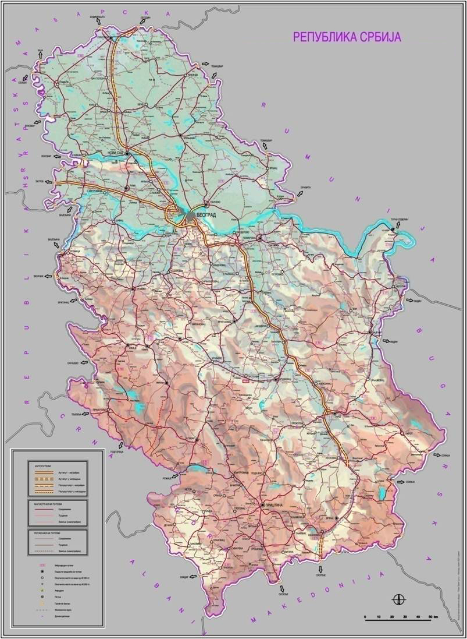
ROAD
NETWORK
OF
SERBIA

Slide 3
KEY OBJECTIVE
Increase of the level of service for road users through the new
maintenance principle (Performance Based Contract)
Increase of traffic safety and environmental protection
Introduction of contemporary information technologies in road
network management
Harmonization of legal and technical regulations for roads with
the EU standards
National Road Network Rehabilitation Program

Slide 4
BELGRADE BY PASS

Slide 5
BELGRADE BY PASS
Section A1: E 75 and interchange Batajnica - works in progress
Section A2: E 75 and interchange Dobanovci - works completed
Sector B1- B3: Dobanovci – Ostruznica - works in progress
Sector 4: Construction of the “Petlovo Brdo” and “Orlovača”
Interchanges (phase II) -the public Bid opening for the
execution of works on April 5th 2013, tender evoluation
Sector B5: Orlovača – Avala road – works completed

Slide 6
Sectors B1- B3 Dobanovci -Ostružnica
The construction of Е-70/Е-75 motorway section from "Dobanovci" Interchange to bridge No.8 over the Sava river on sectors B1, B2 and a part of B3 of Belgrade Bypass (Phase II)
Phase II implies the construction of the left carriageway in the direction of chainage increase, i.e. from "Dobanovci" Interchange to bridge No.8, in total length of 10.055 km.
Contract for the execution of works was signed on June 19, 2012 with Joint Venture "Ratko Mitrović-Niskogradnja" LLC - CE "Planum" joint stock company

Slide 7
National Road Network Rehabilitation Program

Slide 8
National Road Network Rehabilitation Program
The first phase of NRNRP is expected to include about 50 - 55 sections totaling 1,125 km.
35 – 40 sections, will be financed by RRSP
15 - 20 sections will be financed by the EBRD Project.

Slide 9
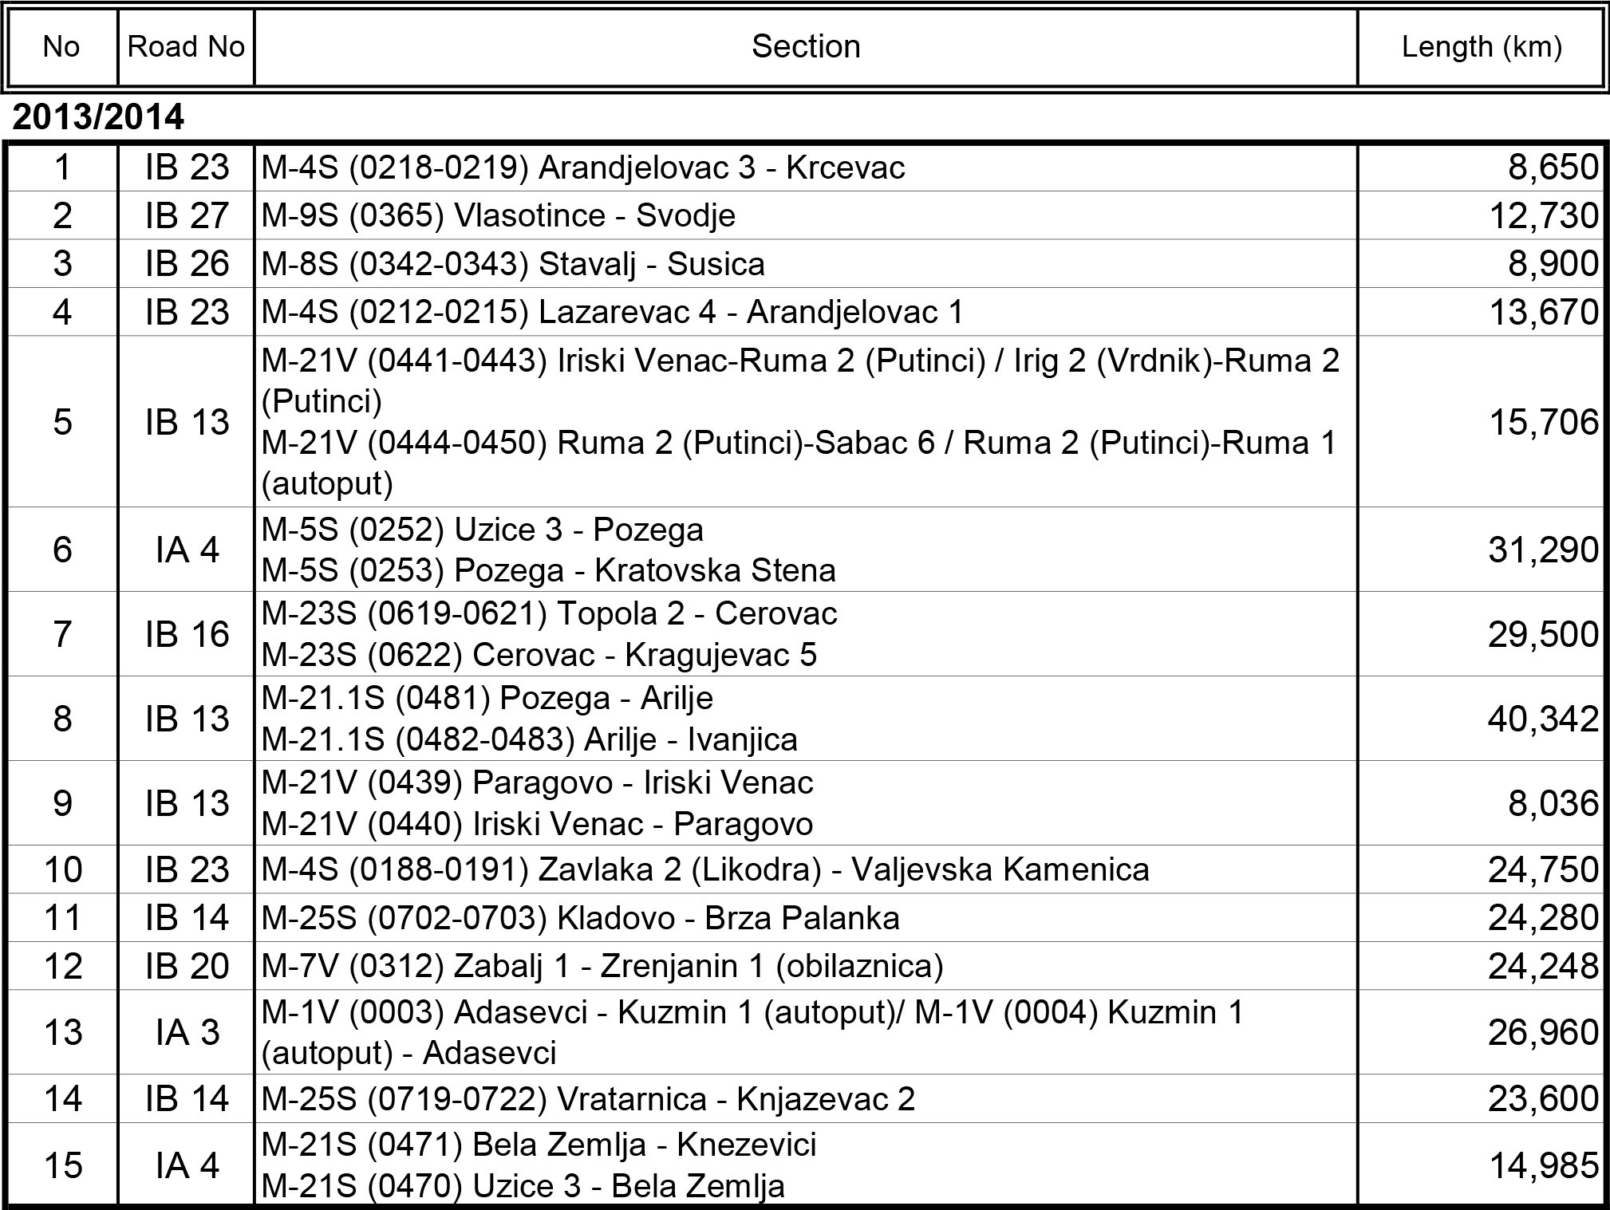
Road and Rehabilitation Safety Project 2013-2017,
Sections

Slide 10
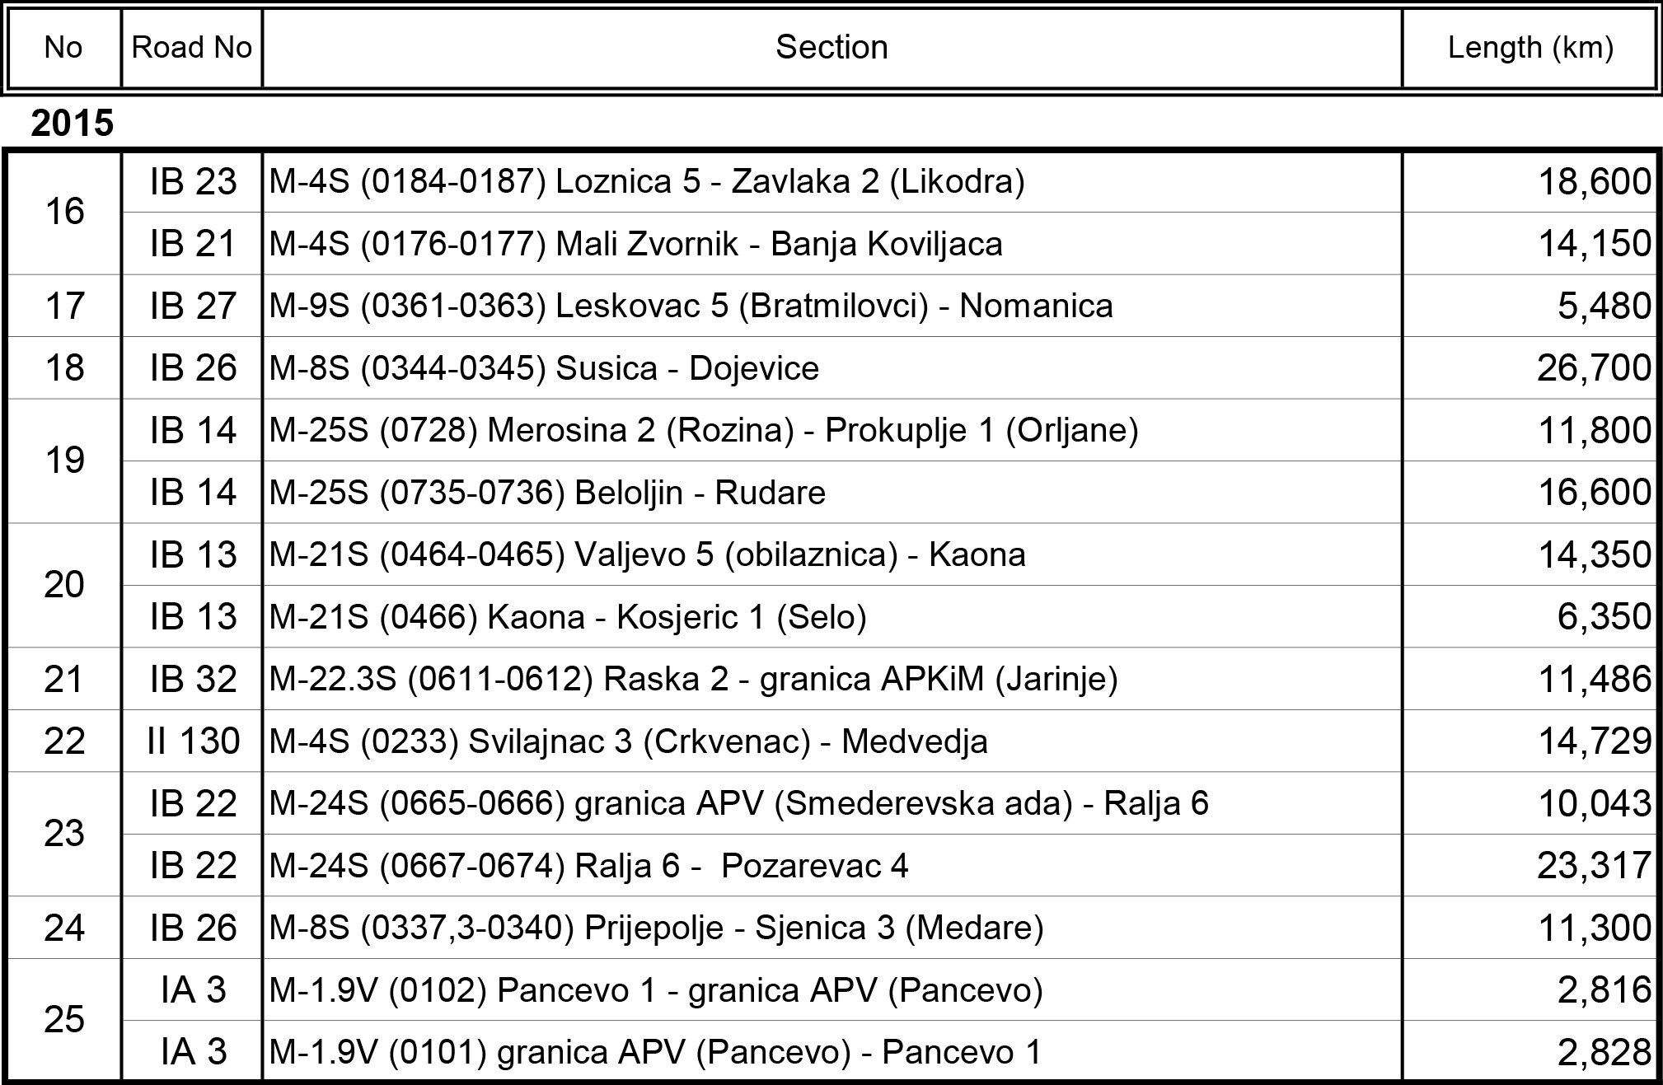
Road and Rehabilitation Safety Project 2013-2017,
Sections

Slide 11
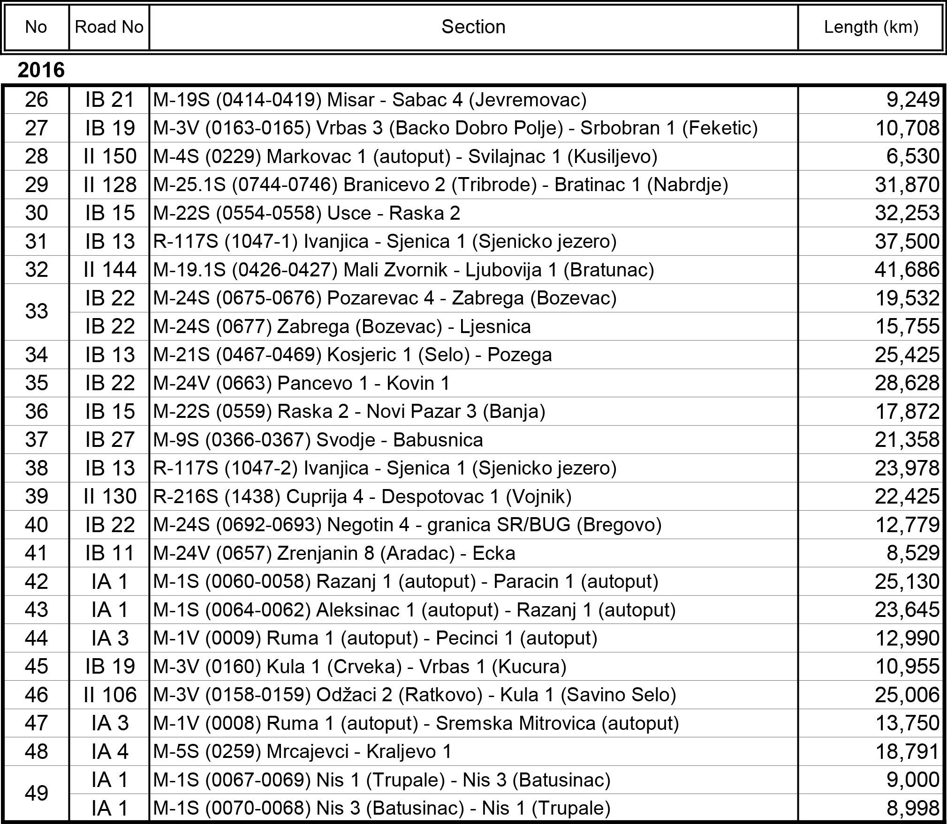
Road and Rehabilitation Safety Project 2013-2017,
Sections

Slide 12
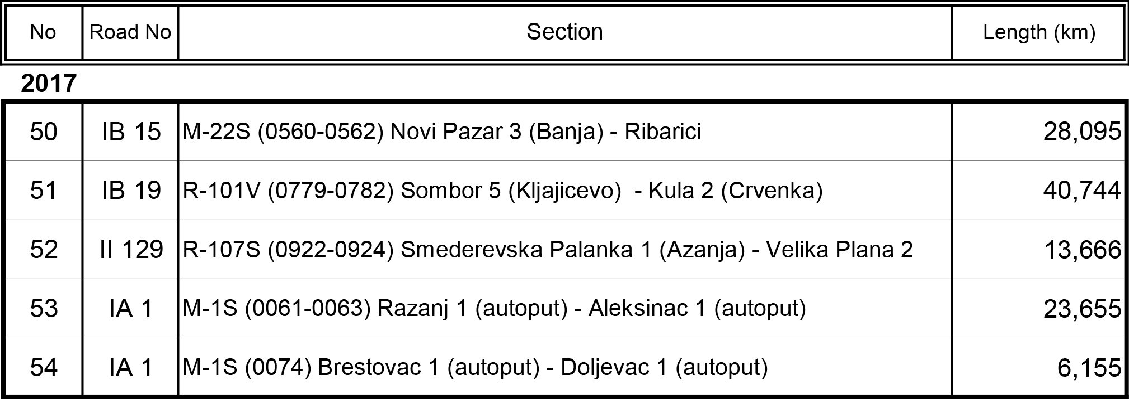
Road and Rehabilitation Safety Project 2013-2017,
Sections

Slide 13
Thank you for your attention!

