Slide 1
Government of Montenegro Ministry of Transport and Maritime Affairs
Podgorica, April 2013

Slide 2
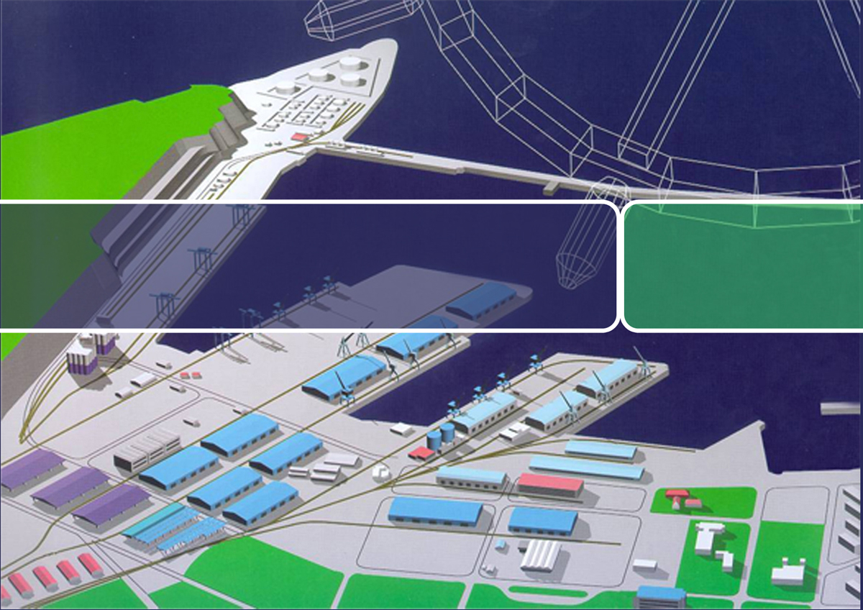
PORT OF BAR
Development of capacities for liquid cargoes/Free Zone Port of Bar

Slide 3
Introduction
Development of capacities for handling and storing liquid cargoes is one of the development priorities of the Port of Bar as well as development of activities under Free Zone regime;
As the variant of further development of capacities for liquid cargoes, defined in the existing Detail Urban Plan for the Port Zone, is connected with high required investments in infrastructure, in the Port of Bar are initiated activities directed to finding alternative variant which considers smaller investments in infrastructure;
With the next slides are given basic details referred on the Liquid Cargo Terminal development variant defined now in the Detail Urban Plan as well as details related to modified development variant;
Basic information about the Free Zone Port of Bar and investment opportunities appeared there are given in this presentation, too.

Slide 4
New Terminal for Liquid Cargoes –
according to Detail Urban Plan (1)
In the existing Detail Urban Plan is foreseen development of a new terminal in the Bigovice bay zone, as shown with the next slide;
Idea inserted in the Detail Urban Plan considers building complete new infrastructure: breakwater, quays, roads, etc.; building new reservoirs of 250 000 m3 capacity; building underground reservoirs of 500 000 m3 capacity; building a new tunnel through Volujica Hill; as well as building a new loading/unloading station for wagons and trucks;
Concretization of this variant requires very high investments in infrastructure – some preliminary rough estimations are that expected investments in infrastructure would be bigger than 500 million EUR;

Slide 5
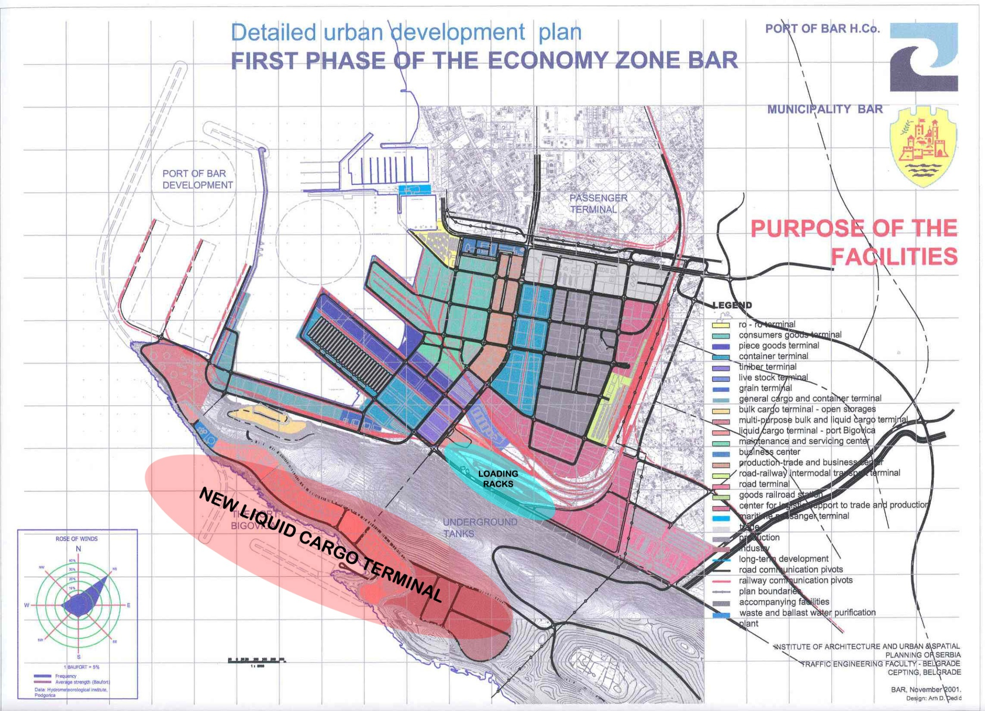

Slide 6
Alternative variant of development capacities
for liquid cargoes (1)
Having in mind high level of required investments in infrastructure as a precondition of previous variant realization, in the Port of Bar were initiated analyses directed to finding more rational solutions;
An identified modified development variant considers maximal usage of existing infrastructure; by the variant are mainly foreseen investments in reservoirs, pipelines and loading/unloading station;
Basic elements of the variant, shown with the next slide, are: usage of existing berths for liquid cargoes (capable to receive ships up to 80 000 dwt) (marked as “built”); extension of existing berth at Dry Bulk Cargo Terminal and equipping it for berthing liquid cargo carriers (marked as “un-built); building new reservoirs behind the Volujica Hill and connecting them (through existing tunnel) with berths with pipelines (yellow line); building new loading/unloading station for wagons and trucks (marked as “loading racks”) ;
As the innovation of the Detail Urban Plan for the Port Zone, initiated by the Port of Bar and the Municipality of Bar is under way, The Port of Bar will propose to insert this variant in the Plan;

Slide 7
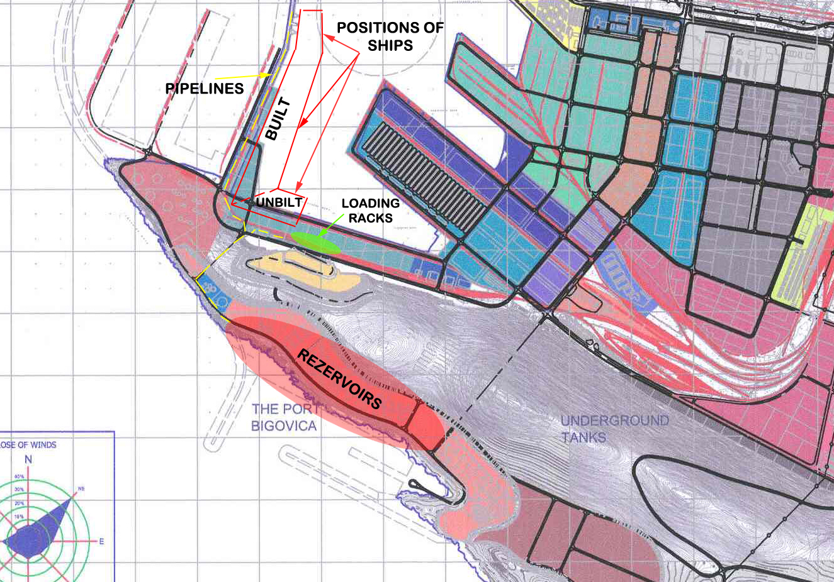

Slide 8
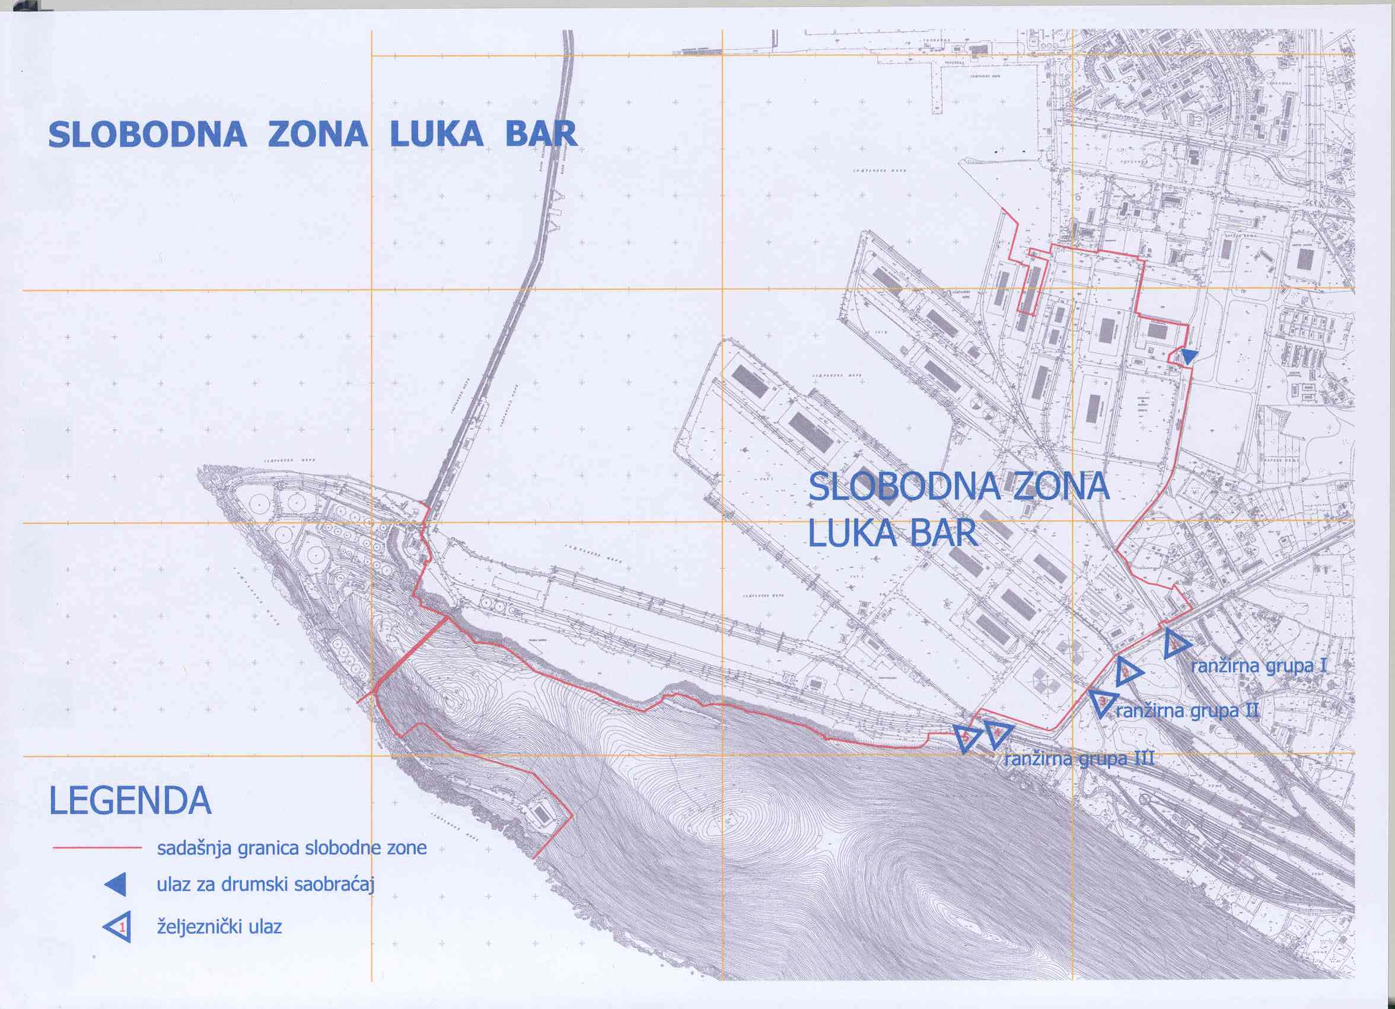
Port of Bar Free Zone – basic information (1)
FREE ZONE REGIME
The free zone legal regime is governed by the Free Zone Act, Customs Act, Decree on Customs Act Enforcement and General Regulations of Carrying out Business Activities in the Port of Bar Free Zone.

Slide 9
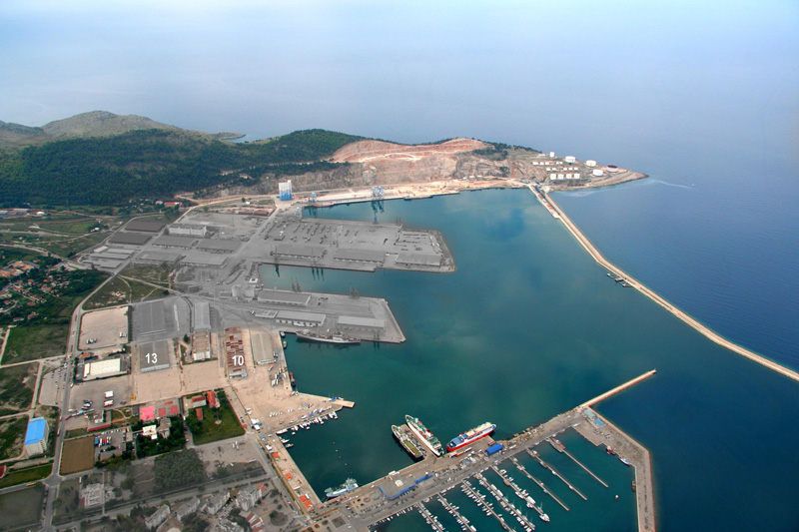
Port of Bar Free Zone – basic information (2)
The free zone regime is applied to the whole area and all the terminals & facilities of the Port of Bar, excluding some smaller parts - Gate 5 and Gate 3.
The Port of Bar (Luka Bar AD) is the authorized operator for the whole Zone:
“1”its own area and facilities (bulk, liquid and special cargo terminal, grain terminal, production & trade center etc.), and
“2”the area belonging to Container Terminal and General Cargo.
1
2
1
The total area of the two companies with the free zone regime amounts to more than 130 ha, with a possibility for further expansion, in accordance to requirements of users.

Slide 10
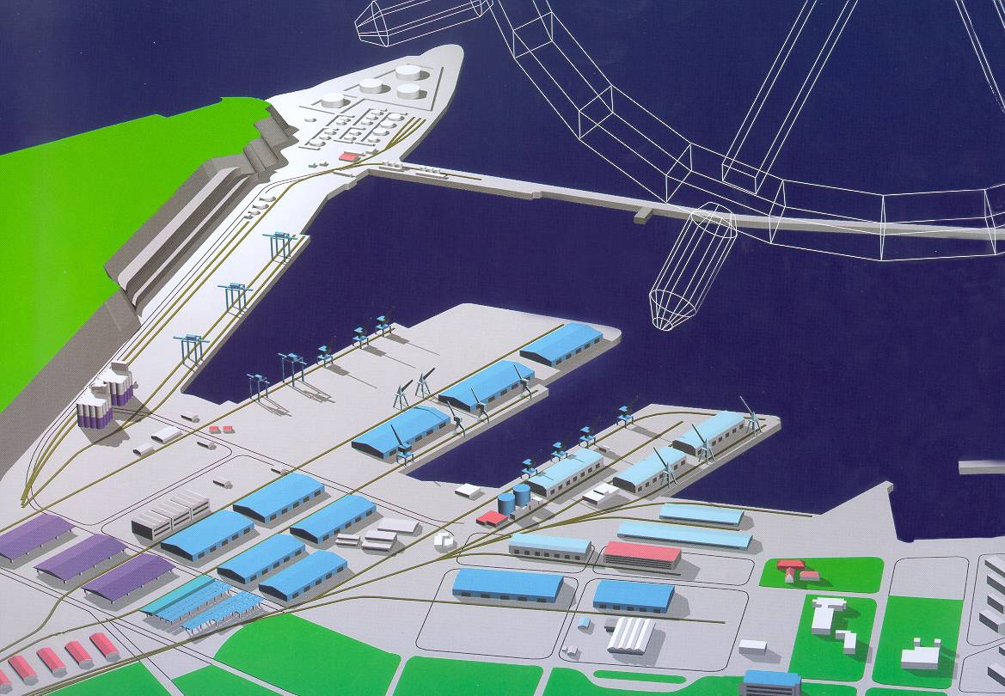
Port of Bar Free Zone – basic information (3)
All facilities of the Port of Bar are potentially in function of the Free zone. Exploitation of certain categories of these facilities can be various: exclusively for new activities of the Free zone (certain facilities and areas), simultaneously for port activity and activity of the Free zone (mechanization and equipment), occasionally for activity of the Free zone (operational quays, berths, warehouses,...) as well as other models.

Slide 11
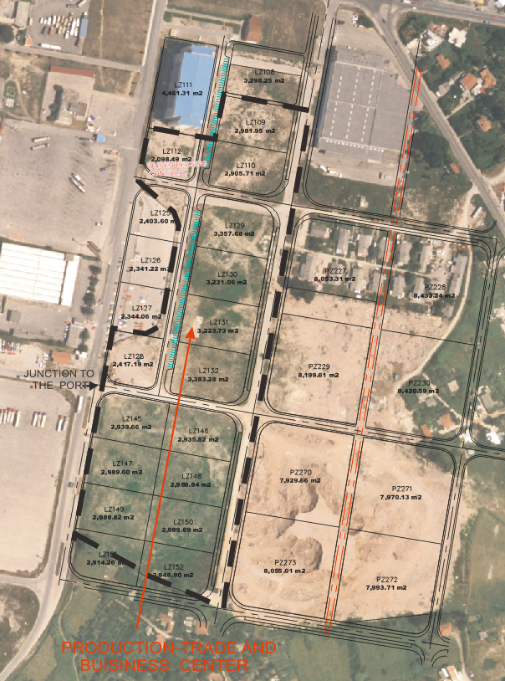
Port of Bar Free Zone – basic information (4)
Production & trade center (Industrial Zone) covers the area located along north-eastern section of the Port complex with total area of 8,5 ha. It is purposed for production and commercial activities under the zone regime or regular legal regime, depending on the caracter of a user`s activity. The area is equipped with internal traffic and atmospheric sewerage network, with infrastructure connections at the borders of the area or close to it. The land is offered for rent to zone users and other business partners, so that they can construct their own production or warehousing facilities.
The Production & trade center is connected to an additional development land area of 10 ha.

Slide 12
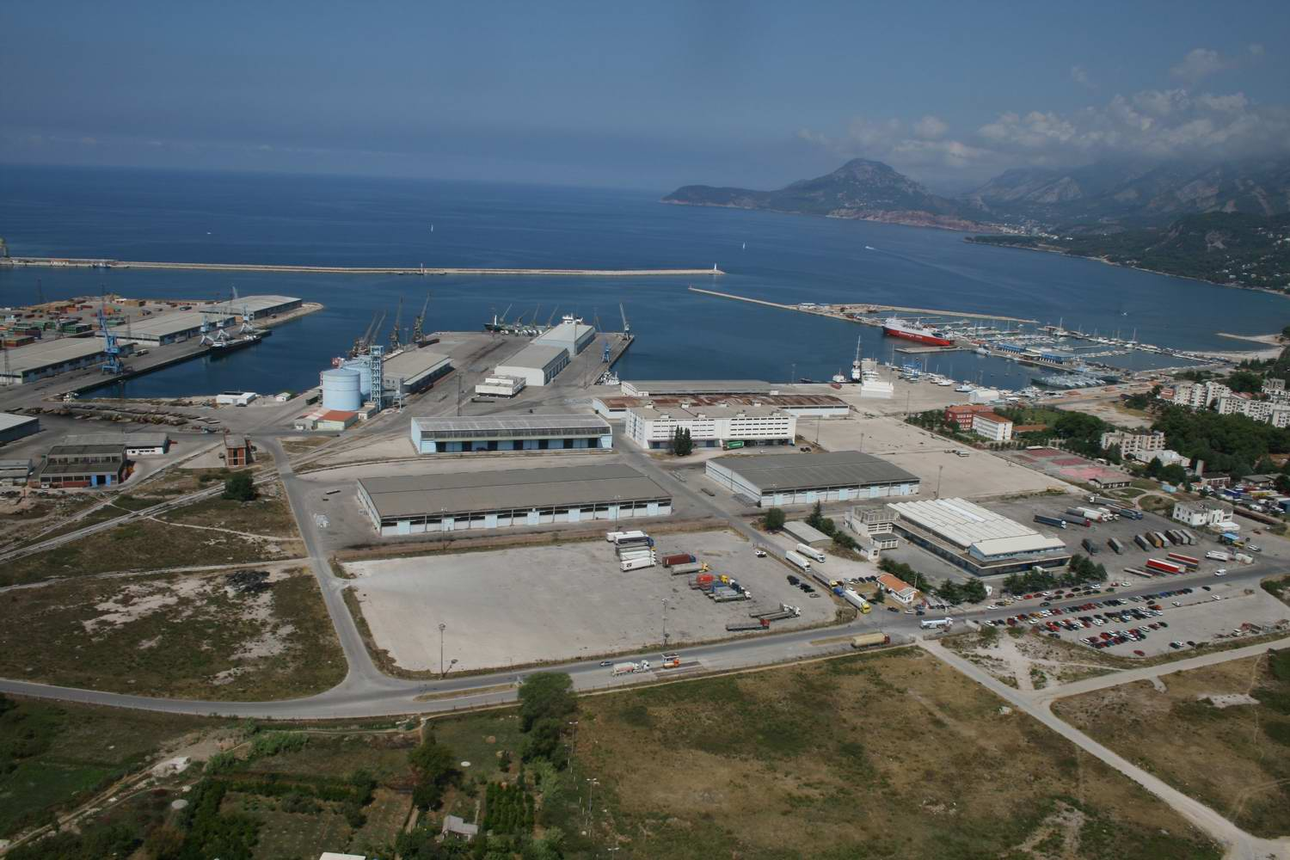
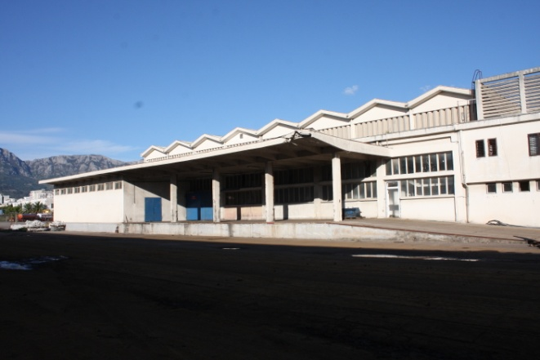
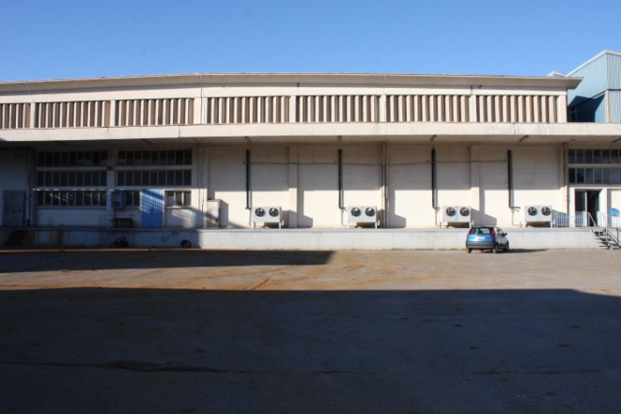
Port of Bar Free Zone – basic information (5)
Cold storage facility is located in the close vicinity of the operational quay (about 300 m away) and goods can be transported to the plant by road and rail (there are two railway tracks immediately adjacent to the plant). Cold storage facility covers app. 7.800 m² net area.

Slide 13
Port of Bar Free Zone – basic information (6)
ZONE ADVANTAGES:
Some of the most important advantages that could be a reason for a company to become the Port of Bar Free zone user are:
All economic activities can be carried out within the Free zone except those that are threats to the environment, health of people, material goods and security of the country;
Investors from abroad have completely equal conditions in terms of right to invest, obtaining ownership rights on constructed facilities and organizing activities in them;
Land and facilities in the zone are used according to long term lease contract under favourable and fixed conditions;
Goods entering the Zone are not liable to customs, custom duties and value added tax regardless of the type of imported goods and its purpose in the Zone;

Slide 14
Port of Bar Free Zone – basic information (7)
ZONE ADVANTAGES:
Goods entering the Zone are not liable to foreign-trade restrictions (permits, quotas etc.);
The users make payments freely, in accordance with the agreed manner and within the agreed terms, through a bank in the zone or other bank out the Zone;
Goods stored in the Zone are allowed to stay in it for unlimited period of time;
Goods may be temporarily taken out from the Zone into the other part of Montenegro or enter into the Zone from the other part of Montenegro for the purpose of its improving, assembling, testing, repairing, marketing presentation and so on;
Low corporate income tax rate (9%);
etc.

Slide 15
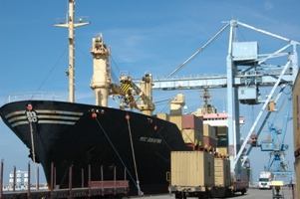
Privatization of company Container teriminal and General Cargo Bar
Tender indicative planning Rebel group – privatization consultant
2013 year
March - send out tender documents
June - submission of proposal
September - selection of preferred candidate
October - signing of contract

Slide 16
Privatization of company Container teriminal and General Cargo Bar
Timber terminal - Timber terminal has a covered storage area of 24 200m2, which is designed for storage and drying of timber. It has ideal technological solution for handling, storage and for the functionality of facilities, all designed according to prevailing microclimate influences.
The possibility to accept different type of ships according to international common practice, with declared draft between 9 and 12 m, represents a real market potential. All warehouses are built of quality construction materials of universal character. The railroad reaches every berth and warehouse, so that direct handling activity road-railroad-ship is possible. Depending in the length of ships 5-9 berths with different type of cargo and different handling activities can be simultaneously organized handling activities can be simultaneously organized.

Slide 17
Privatization of company Container teriminal and General Cargo Bar
Government of Montenegro has a strategic plan to sell 62,09 % of its equity stake at Container Terminal and General Cargo JSC-Bar, which represents the majority of shares, and conclude a concession agreement with future terminal operator.
Container Terminal and general Cargo JSC – Bar is a joint stock company listed on the Montenegro Stock Exchange.
Total equity capital is 71 248 339,38 EUR, divided into
shareholder's equity amounting to 65 196 596 euros or 56 766 736 shares, trading symbol KOGE and
shareholder's equity amounting to 6 051 803 euros or 12 040 993 shares, trading symbol KOTE .
Nominal value for 1 share, trading symbol KOGE is 1,1485 EUR.
Nominal value for 1 share, trading symbol KOTE is 0,5026 EUR

Slide 18
Thank You for your Attention

