Slide 1
RENEWABLE ENERGY SOURCES
Confindustria – Belgrade, 15th April 2013
ENERGY BLOCK
Oreste Bramanti
RES Department Director

Slide 2
Summary
NIS GAZPROM NEFT
  About us
  Strategy
Energy Block
  Objectives and strategy
  Renewable Energy Sources (RES) department
  Social-Environmental background of RES
  Serbia RES-power potential
Biomass and Biogas
Wind energy
Geothermal energy
Hydropower
Solar energy
Conclusions

Slide 3
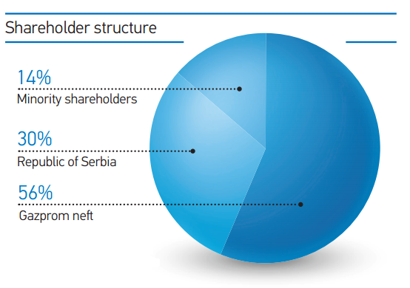

Nis GAZPROM NEFT
About us
The Gazprom Neft Group includes about 80 crude production, refinery and marketing companies in Russia and across Europe, which are organized in a vertically-integrated structure. The Company refines more than 80% of the oil it produces which is in terms of value is an optimal level between production and processing.
NIS is modern vertically integrated energy company one of the largest of its kind in South-East Europe.
Gazprom Neft is the fifth largest Russian oil company by crude oil production
The entering of Gazprom Neft, as a majority shareholder, in the ownership structure of NIS brought a thorough restructuring of the Company, with the basic objective to increase NIS competitiveness at the market.
In June 2010 NIS was transformed into an open joint stock company, and is listed on the Belgrade Stock Exchange since August 30, 2010.
Main business activities of NIS are:
upstream
refining
sales and distribution
oilfield services
energy

Slide 4
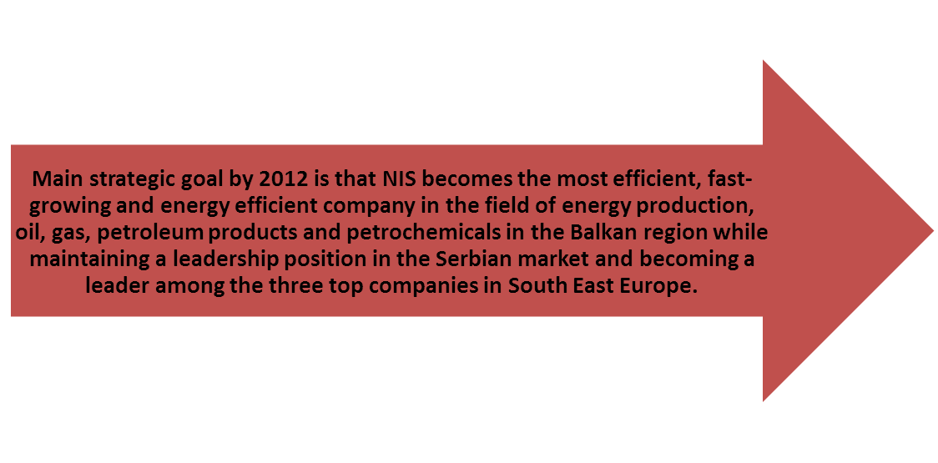

5 million tons of crude oil and gas produces
5 million tons refined
5 million tons oil products sold
Euro-5 standard of process and result
Value of one NIS share will be 5.000 dinars
NIS Development Strategy entails implementation of the programme “FIVE FIVES“ that includes:
2020

Slide 5

Energy Block
In line with the company’s strategy to become a leading energy company in the Balkan region, the Energy organizational unit was established in 2011
The most attractive markets outside of Serbia are the surrounding countries (Balkan countries)
The basic objectives of a new direction in business operations include:
Synergy with other NIS organisational units in the field of natural gas and electrical energy consumption
Business diversification
Reducing negative consequences from external factors
Using unique possibilities in Serbian and regional energy market development
Adopting best practice from leading regional and global energy companies
Developing business and improving company image, having in mind future stipulations concerning energy efficiency, environmental protection and use of renewable energy sources

Slide 6

Energy Block Strategy
Increased power usage in Serbia
Increased natural gas usage in the region, due to its environmental friendliness
Use of clean renewable energy sources in Balkan region
Improving NIS energy efficiency
Use of modern technologies for energy production by using domestic energy sources with minimum impact on the environment
Business optimisation for energy and natural gas trade in liberalized market as well
Renewable Energy Sources (RES) department
Has been formed in 2011 and is engaged in the development and implementation of projects of electricity and thermal energy production from:
WIND
GEOTHERMAL
ENERGY
BIOMASS
BIOGAS
SOLAR
ENERGY
HYDRO
ENERGY

Slide 7
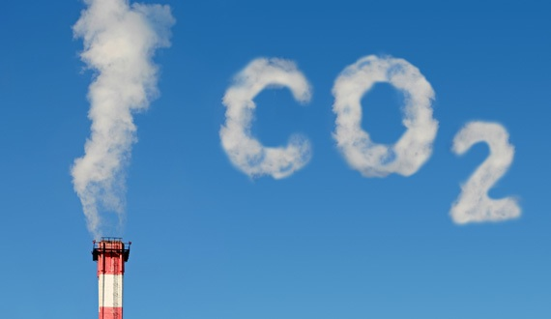
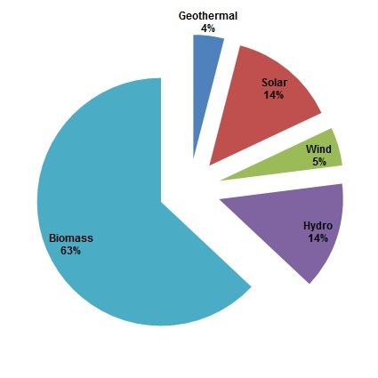
Social-Environmental background of RES
The targets of current Climate Change Challenges are to create more energy, securing it’s increasing demand and to lower CO2 emissions
Energy production from renewable energy sources is greatly reducing the amount of emitted CO2
NIS has already carried out a preliminary data collection and indicative assessment of CO2 emission or equivalent GHGs, coming from the existing and operating assets under business activities in Republic of Serbia
NIS defined long-term objectives in complies with:
    national strategies in the field of environmental protection
    Company's strategy in the field of environmental protection, which complies with the obligations under the Law on Integrated Pollution Prevention and Control, obligations under the Kyoto Protocol and EU directive 20/20/20
    program of transitions of certain plants to renewable energy
Serbia RES-power potential
Energy potentiolnal of the renewable sources in the Republic of Serbia is very significant and estimated at over 4.3 million tons of oil equivalent or „toe“ per annum

Slide 8
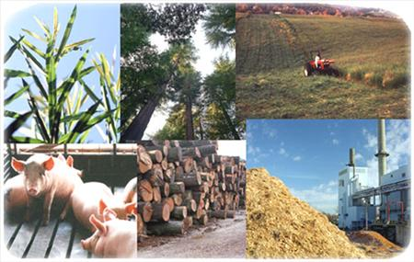
Biomass and Biogas
Our task
Biomass include agricultural products, by products and waste (vegetable and animal), waste from forestry and associated industries, as well as part of industrial and municipal wastes which is biodegradable
Biogas is a gas that is released during the decomposition of organic wastes and by-products formed in industry, agriculture and domestic, under anaerobic conditions
Serbia has an annual biomass potential of 2.7 million tonnes of oil equivalent
No major project for the production of energy from biomass has not been realized so far in Serbia
NIS in cooperation with respectable partners has an outstanding opportunity to become the first leader in the production of energy from biomass in Serbia and region

Slide 9
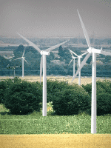
Wind Energy
Our task
Wind energy is the kinetic energy of air in motion and currently is the most common type of renewable energy in the world
Wind project development is a time–consuming activity and needs proper management of many stakeholders as well as several tecnical topics and permitting issues
There are suitable locations with relevant source potential for installations of wind farms in Balkan region
It is estimated that there could be technologically justified wind source of around 0.2 million tonnes of oil equivalent potential in Serbia, which could replace 10% of total electric energy consumption
Implementation of projects in cooperation with industrial strategic investors
Limitation: The right to incentive measures set forth in Decree for electricity produced in power plants that use wind energy is limited to the total installed power up to 450MW in those power plants

Slide 10
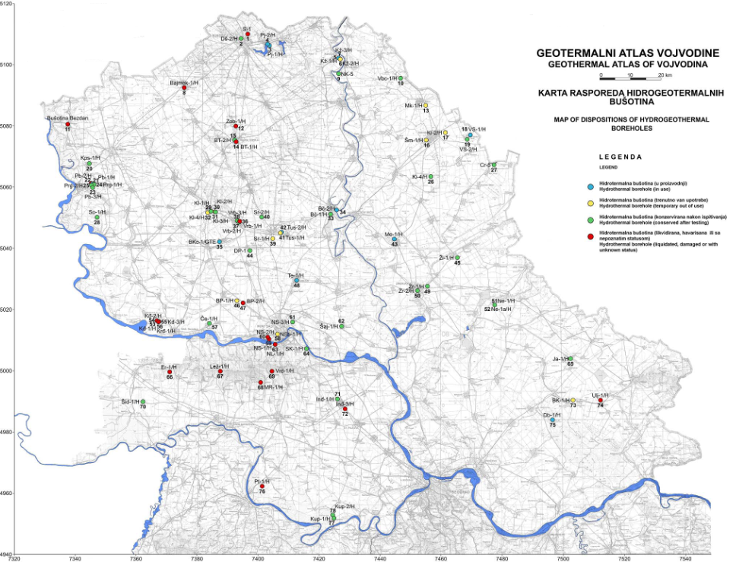
Geothermal energy
Our task
In Serbia temperature of underground water ranges from 10 to 150°C
The annually potential of geothermal waters in Serbia is equal to combustion of 200 000 tonnes of oil
During the heating season, heating plants in Serbia spent 320 million € on fuels. Using energy from geothermal sources these costs could be reduced by half
NIS currently possess 52 geothermal wells (10 already in operation for heating)
Big potential from wells which have finished production of oil and gas and opportunity to be used for production of geothermal water
Plan for usage of geothermal water:
  Power generation from geothermal water (requests: temperature above 100°C and flow rate above 30 l/s)
  District heating of cities and individual consumers (spa, green houses, etc.)

Slide 11
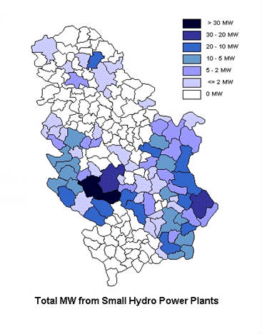
Hydropower
Our task
  In Serbia, approx. 10.4% of the total energy potential in rivers could be used for building small hydropower plants
  Serbia has 0.6 million toe per annum in the unused potential of hydro power
  Serbian potential of hydropower generation is 19TWh/year, out of which:
    18 TWh/year hydro power plants (HPP) with the power capacity above 10MW;
    1,8 TWh/year small hydro power plants (SHPP) with the power capacity up to 10MW
  The major rivers as Danube, Sava, Drina which belong Black Sea drainage basen present the most important hydro power asset
  Mini hydropower plants is great potential for the production of electricity in Serbia
  Small hydropower plants are suitable for both the power supply for isolated consumers and for the development of tourism, agriculture, water supply and other activities primarily country households

Slide 12
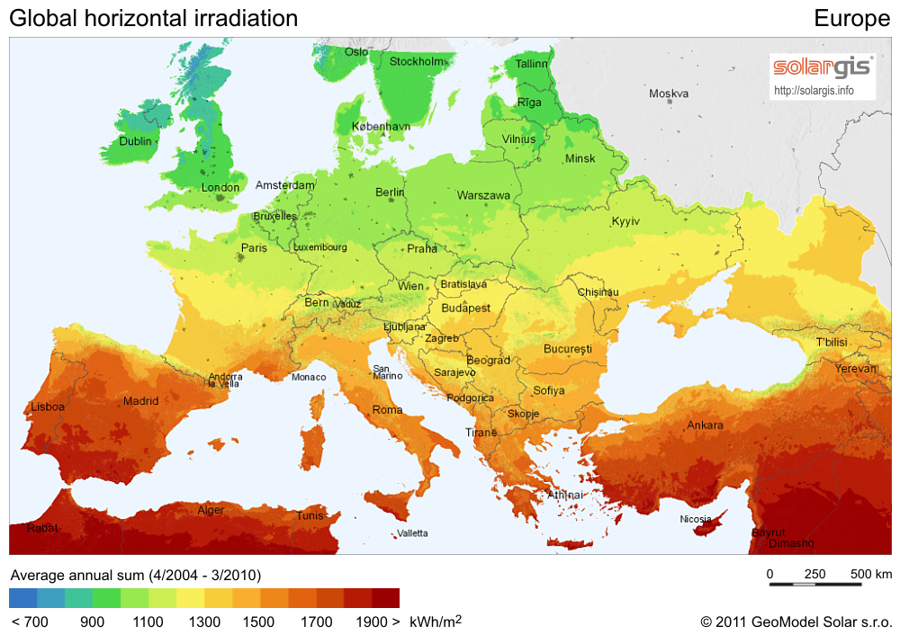
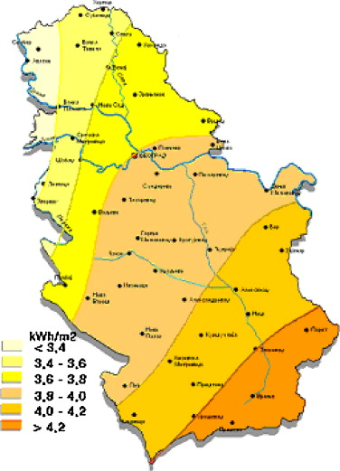
Solar energy
Our task
The average solar radiation in Serbia is about 40% greater than the European average, but still the use of solar energy for electricity generation is far behind the countries of the European Union
The potential of solar energy is 16,7% of total of useful potential of RES in Serbia
Serbia has an annual potential of 0.6 million tonnes of oil equivalent in solar energy
Average daily energy of global radiation for flat surface during winter ranges between 1.1 kWh/m² in the north and 1.7 kWh/m²in the south, and during the summer period between 5.4 kWh/m² in the north and 6.9 kWh/m² in the south

Slide 13
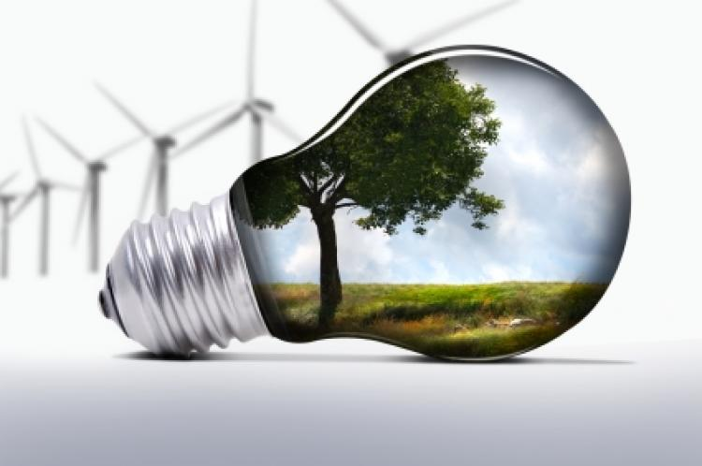
Conclusions
NIS wishes for the future „business Environment“
Since Serbia is in the group of countries whose energy consumption, particularly electricity, is not too rational, it is necessary to increase interest in renewable energy sources (RES) and allow educating people about the importance and benefits of energy efficiency and using green power
To become a leading energy company – a leader among competitors in South European market
To become a regional player with the fastest growth in production, refining and retail sales volume the Balkans
To give the people of Balkan region energy by responsible use of natural resources and modern technology

Slide 14
Your attention
You for
Thank

