Slide 1
Investment opportunities in the area of environment in Montenegro
Ivana Vojinović, MSc
Deputy Minister
Ministry of Sustainable Development and Tourism
Visit of the Delegation of Confindustria to Montenegro
Podgorica, Hotel Podgorica, April 17th 2013

Slide 2
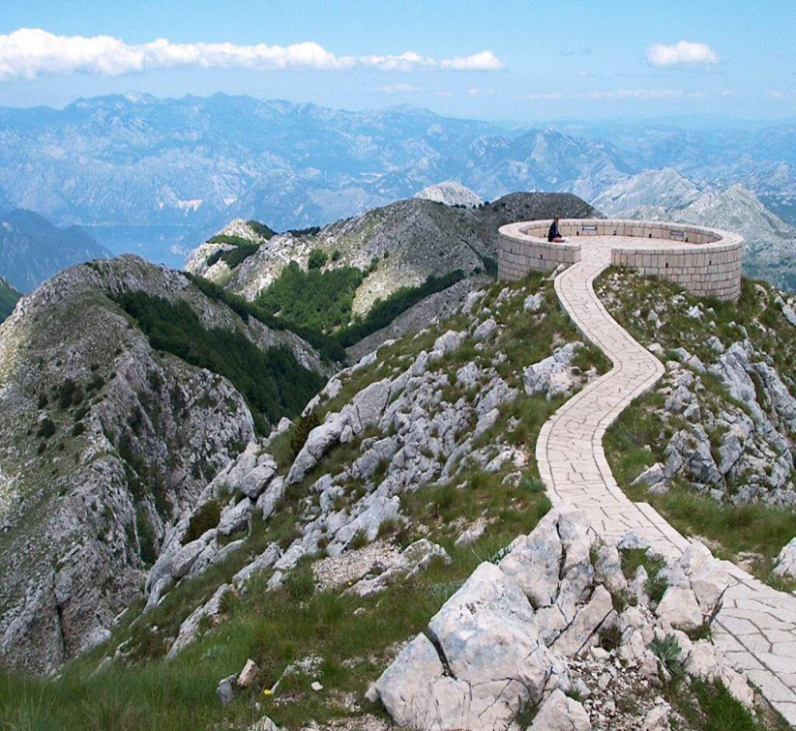
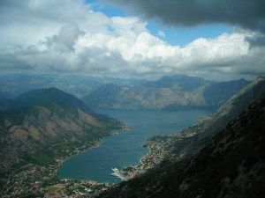
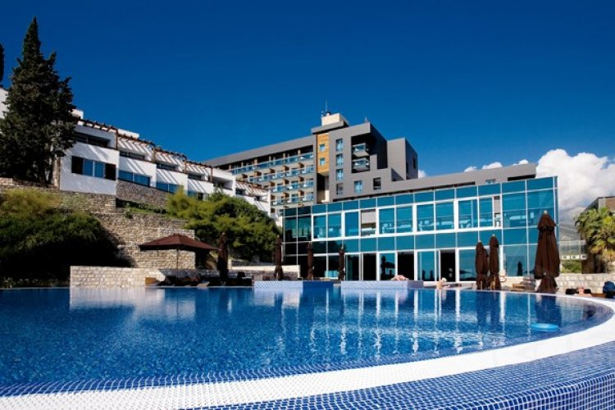
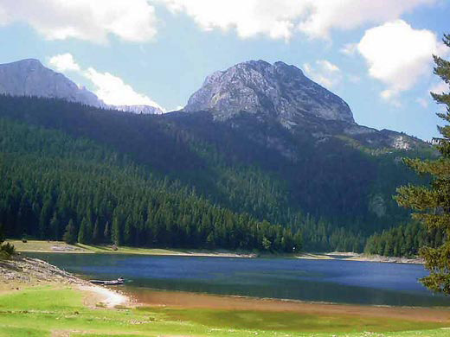
Montenegro was declared as ecological state in 1991

Slide 3
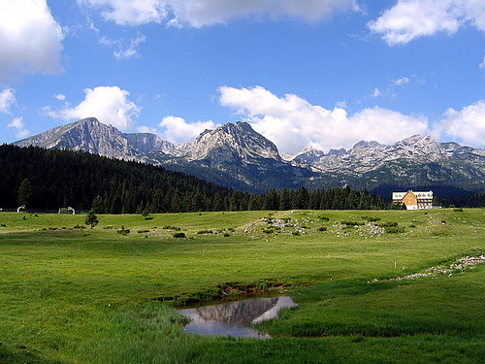
„Hot-spot” of the European and world biodiversity
Position of Montenegro on the main migratory corridor for birds (Adriatic corridor) makes it habitat for numerous birds.
About 60% of the country ais composed of the forests of hight quality, 45% are natural forests
Coastal area of Montenegro together with the Skadar lake, Lovćen and Prokletije is the most important center of biodiversity of reptiles and amphibians on Balkan Peninsula and Europe
Out of 526 species in Europe, 330 are regularly occuring

Slide 4
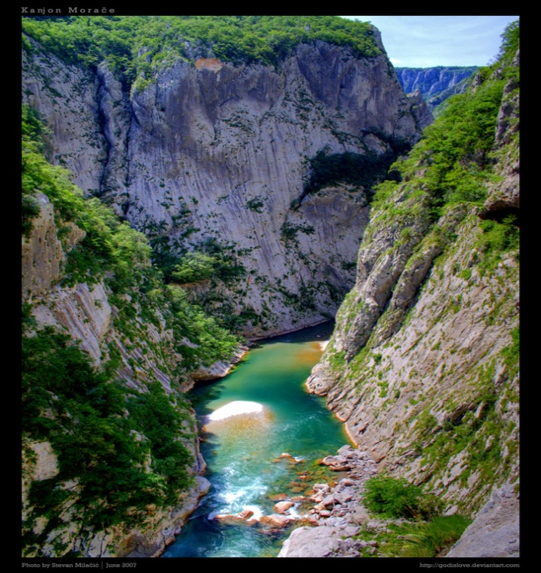
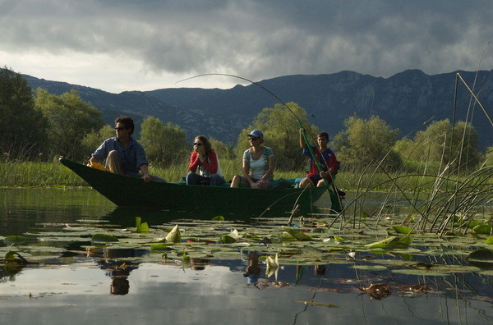
Network of protected areas
International level:
River basin of Tara, M&B UNESCO Biosphere Reservat, including NP Durmitor with Tare Canyon
International level:
- Skadar lake and Tivatska solila – Ramsar Wetlands (habitats of water birds)
International level
Kotor – Risan Bay
National level:
5 National parks
-monuments of nature
Landscapes of special characteristics
Strict nature reservats
TOTAL: 9,047%

Slide 5
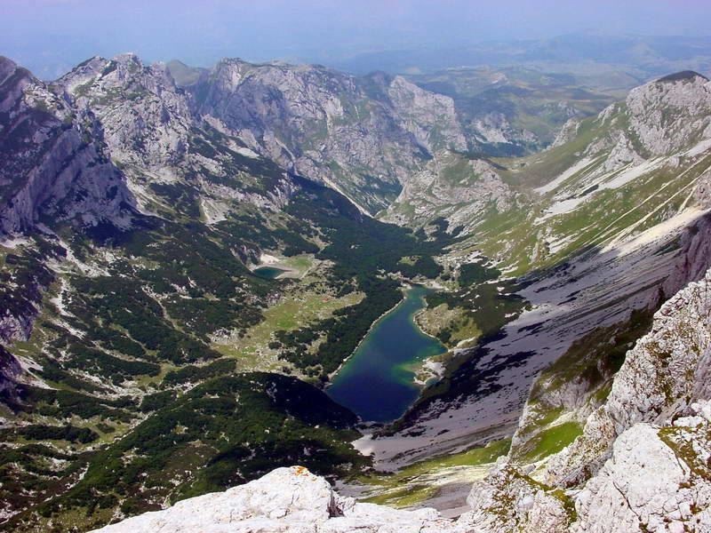
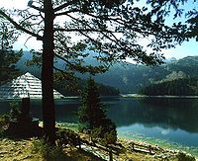
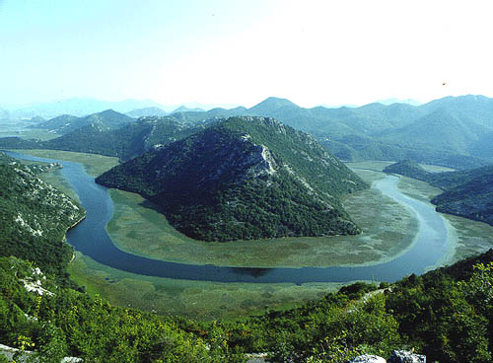
According to the UNDP Study total economic value of protected areas amounts to €68.000.000 ili 2.2 % BDP-a (€106 per capita).
Eco tourism
Organic agriculture
Eco Tourism
Renewable Energy Sources
Small HP, Wind Farms, Solar Panels, Biomass
Green Economy

Slide 6
Investment opportunities in waste treatment
Treatment of non hazardous waste
Treatment of non hazardous waste

Slide 7
According to MONSTAT the following amounts of waste are generated annually in Montenegro :
approximately 230 000 t of municipal waste, and
approximately 145 000 t of biodegradable waste.

Slide 8
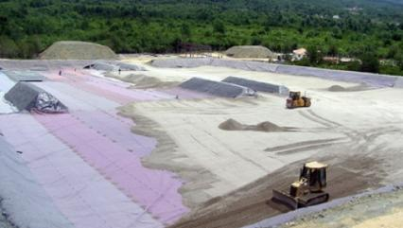
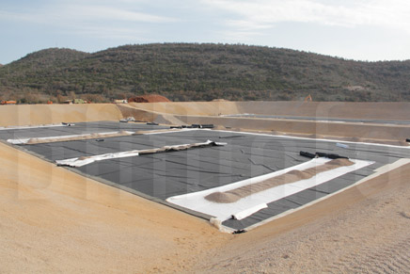
Operational landfills for municipal and non-hazardous waste: Livade (Podgorica, Danilovgrad) and Mozura (Bar, Ulcinj).
According to the Strategic Master Plan for Waste Management it is planned to construct additional regional landfills, for which, in accordance with initial technical documentation, it is necessary to provide funding in the amount of approximately 70 million euros (for Phase I approximately 40 million euros).

Slide 9
Numerous opportunities in the area of different waste streams systems treatment
Main challenges in this area
Separate collection of waste, reuse and recycling of particular fractions of waste in the amount of 50% by 2020.
Separate collection and special treatment of biodegradable waste, to ensure that 35% of the total amount of municipal waste produced in Montenegro is disposed of at landfills by 2025 .

Slide 10
At least 50% of the total weight of collected waste materials such as paper, metal, plastic and glass from households and other sources is prepared for reuse and recycling.
At least 70% of non-hazardous construction waste is prepared for re-use and recycling and other ways of recovery.

Slide 11
80% of recovery and 75% reuse or recycling of the component parts, and waste material taken from large home appliances and vending machines;
75% of recovery and no less than a 65% reuse or recycling of the constituent parts and materials taken from waste equipment for information technology (IT);
70% of recovery and no leas than a 50% reuse or recycling of the parts and materials taken from waste in small household appliances, lighting equipment, electrical and electronic tools, toys and equipment for the leisure and sports and instruments for monitoring and supervision.

Slide 12
95% of the total mass of annually collected end-of-life vehicles is reused or recovered or 85% is reused or recycled;
the extent of collection of waste batteries and accumulators is 45% of the total annual mass of batteries and accumulators placed on the market;

Slide 13
Packaging waste (55% goal):
60% of the weight of glass;
60% of the weight of paper and paperboard;
50% of the weight of metal;
22.5% of the weight of plastic, where this applies only to the material which is again recycled into plastics;
5% of the wood mass.

Slide 14
Concessionary Act was adopted by the Government of Montenegro for performing the activities of acceptance, collection and treatment of special wastes.
Tender documents are currently under preparation for the selection of processors of waste batteries and accumulators, waste tires, end-of-life vehicles, waste from electronic and electrical products and waste packaging.
The concession is given to carry out the tasks of acceptance, collection and recovery of special wastes throughout Montenegro.

Slide 15
Treatment of hazardous waste
Aluminium Plant Podgorica (KAP)
Thermal Power Plant Pljevlja,
Bijela Shipyard
Lead and zinc mine tailings Gradac
Ongoing World Bank project - “MONTENEGRO INDUSTRIAL WASTE MANAGEMENT AND CLEAN-UP PROJECT (IWMCP)” $ 60 million
Implementation of the project is planned over the next 5 years.

Slide 16
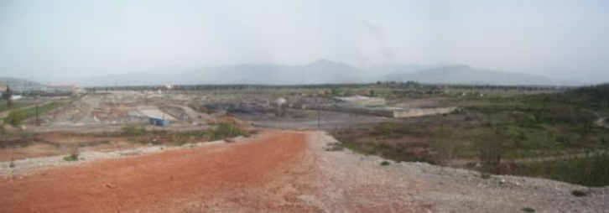
Aluminium Plant Podgorica (KAP)
- solid waste landfills and red mud pool

Slide 17
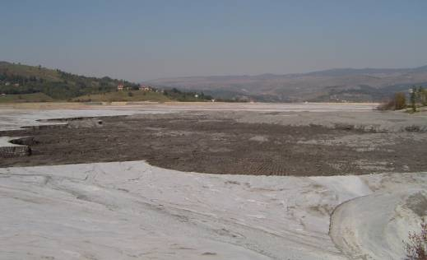
Thermal Power Plant Pljevlja – ash and slag landfill Maljevac

Slide 18
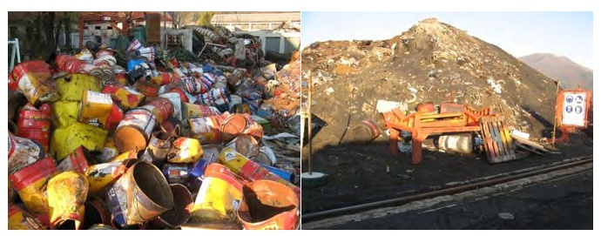
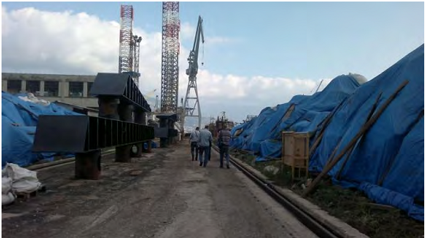
Shipyard Bijela – landfill of used steel grit

Slide 19
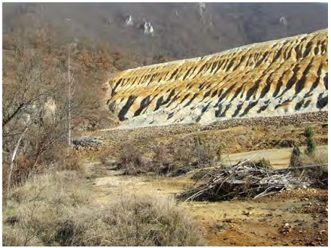
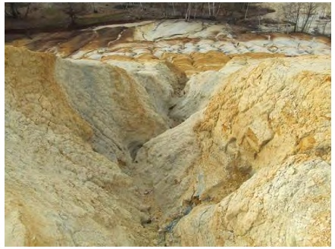
Lead and zinc tailings Gradac

Slide 20
Urban Waste Water Treatment
Sewer systems for the collection of waste water are mainly in the urban parts of the municipality and these systems supply around 63% of the population living in urban areas of municipalities.
Facilities for waste water treatment exist in Podgorica and Mojkovac.
The activities related to the rehabilitation and expansion of the sewerage system in 18 municipalities are in progress.

Slide 21
Municipality | The total population | The population in urban areas | Coverage of urban areas sewerage network (%)
 | (in thousands) |  | spatial | population
Bar | 42,05 | 17,65 | 100 | 100
Budva | 19,22 | 15,99 | 95 | 95
Herceg Novi | 30,86 | 19,54 | 70 | 70
Bijelo Polje | 46,05 | 15,40 | 65 | 60
Nikšić | 72,44 | 56,97 | 80 | 87
Pljevlja | 30,79 | 19,49 | 80 | 80
Podgorica | 185,94 | 155,73 | 65 | 60
Ulcinj | 19,92 | 10,71 | 90 | 91
Tivat | 14,03 | 10,24 | 50 | 90
Kotor | 22,60 | 12,58 | 15 | 42
Cetinje | 16,66 | 14,09 | 40 | 40
Berane | 33,97 | 11,07 | 93 | 93
Danilovgrad | 18,47 | 6,85 | 30 | 30
Kolašin | 8,38 | 2,73 | 7,5 | 10
Mojkovac | 8,62 | 3,59 | 40 | 75
Andrijevica | 5,07 | 1,05 | 80 | 80
Plav | 13,11 | 5,39 | 75 | 75
Rožaje | 22,96 | 9,42 | 67 | 70
Plužine | 3,25 | 1,34 | 80 | 80
Šavnik | 2,07 | 0,47 | 60 | 60
Žabljak | 3,57 | 1,72 | 64 | 68

Slide 22
Urban Waste Water Treatment
The activities for the construction of a wastewater treatment plant are in progress in Niksic (capacity 2x55.000ES), Herceg Novi (capacity 65.000 ES) and Budva (4PPOV capacity 130.000 ES in the first stage of realisation);
The procedure to select a contractor to build a PPOV in Bar (for 68.000 ES) and joint PPOV for municipalities Kotor and Tivat (for 72.000 ES)
Works are contracted for the construction of PPOV in Zabljak (capacity 2000 ES);
Preparation of project documentation for construction of PPOV in Pljevlja (capacity 28.000 ES), Bijelo Polje (2x20.000 ES), Cetinje (20.000 ES), Berane (20.000 ES), Plav (2x9.000 ES), Danilovgrad (2x6.000 ), Rozaje (13.600 ES)

Slide 23
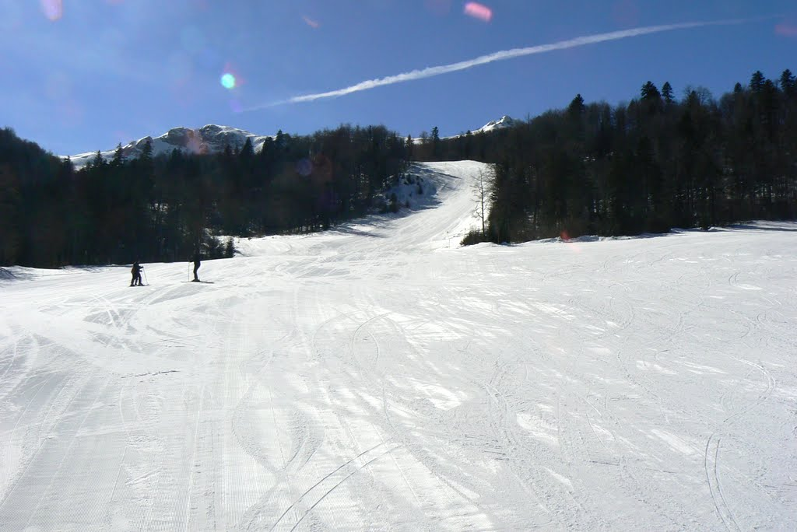
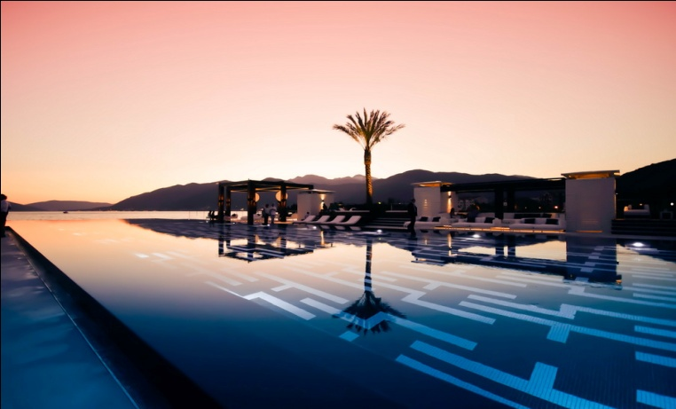
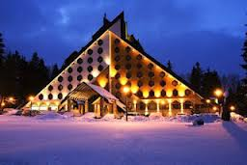
THANK YOU FOR YOUR ATTENTION
Ivana Vojinović, MSc
Deputy Minister
Ministry of Sustainable Development and Tourism
ivana.vojinovic@mrt.gov.me

