Slide 1
MONTENEGRO
INVESTMENT
OPPORTUNITIES

Slide 2
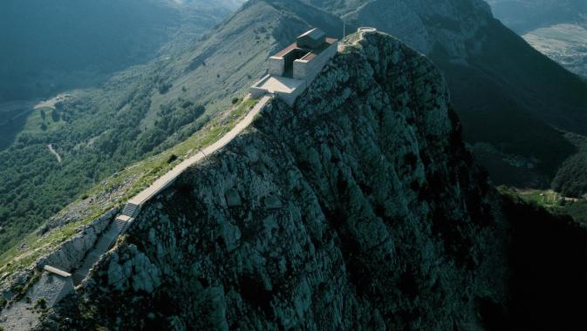
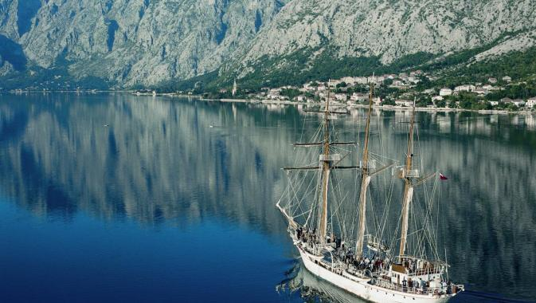
fast facts
area 13.812 km2 (13.452 km2 of land / 360 km2 of sea)
administrative capital Podgorica
royal capital Cetinje
population 625.266
territorial division 21 municipalities
political system parliamentary democracy
official language Montenegrin
official currency euro €

Slide 3
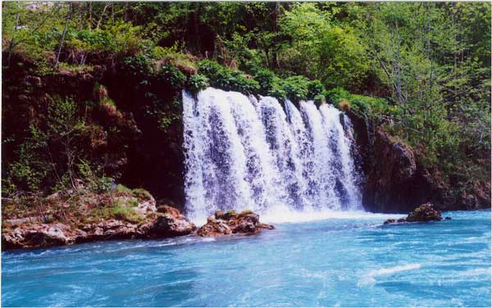
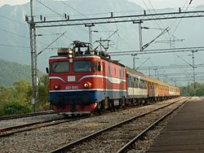
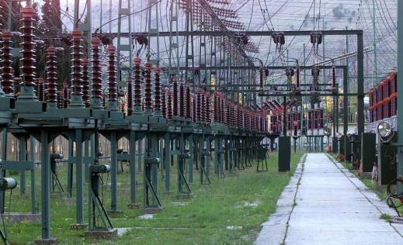
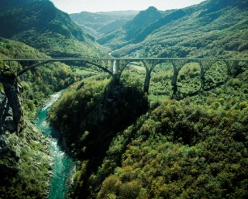
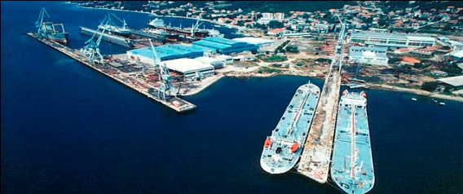
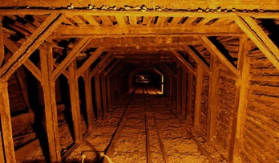
resources
agricultural land 5.165 km2
total arable land 1.899 km2
forests 1 ha per capita
natural lakes 40
accumulation lakes 4
river potential Tara, Moraca, Piva, Cehotina, Komarnica, Bojana…
minerals bauxite, coal, minerals
road network 7.314 km
railway network 393 km
international airports Podgorica, Tivat
ports Bar, Kotor, Risan, Zelenika, Tivat

Slide 4
macroeconomic data
 | 2009 | 2010 | 2011
GDP (million €) | 2981.0 | 3023.0 | 3192.0
GDP per capita | 4,744 | 4,801 | 5,070
nominal GDP growth (in %) | -3.39 | 1.41 | 5.60
real GDP growth (in %) | -5.7 | 1.1 | 2.5
inflation (in %) | 1.5 | 0.5 | 3.0
current public revenue | 45.39 % of GDP | 43.33 % of GDP | 41.69 % of GDP
public expenditure | 51.13 % of GDP | 46.37 % of GDP | 45.00 % of GDP
capital expenditure | 8.43 % of GDP | 5.41 % of GDP | 5.07 % of GDP
current public expenditure | 42.70 % of GDP | 40.96 % of GDP | 39.93 % of GDP
deficit / surplus of public spending | -5.65 % of GDP | -3.03 % of GDP | -3.31 % of GDP
increase / decrease in deposits | 1.99 % of GDP | -2.59 % of GDP | 1.75 % of GDP
the level of public debt | 38.2 % of GDP | 42.3 % of GDP | 45.22 % of GDP

Slide 5
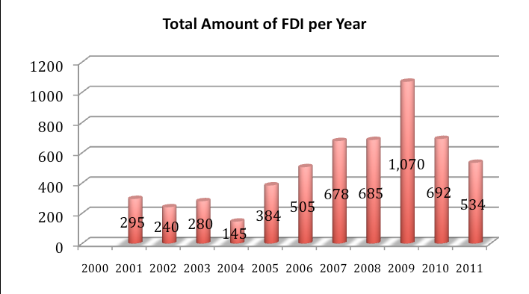
FDI inflow
source: MIPA

Slide 6
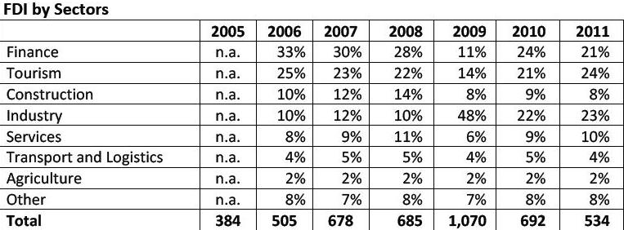
FDI inflow
source: MIPA

Slide 7
FDI inflow
investors from 88 countries
 | State | FDI inflow in € | % Of total FDI
1 | Italy | 486 .804 .302 | 11.8
2 | Russia | 478 .002. 577 | 11.6
3 | Hungary | 355 .691 .493 | 8.6
4 | Great Britain | 322 .229. 047 | 7.8
5 | Cyprus | 309 .760 .754 | 7.5
6 | Switzerland | 305 .170. 662 | 7.4
7 | Austria | 298 .424 .903 | 7.2
8 | Serbia | 159 .497. 818 | 3.9
9 | Germany | 145 .354 .720 | 3.5
10 | Slovenia | 683 .267 | 3.5
source: MIPA

Slide 8
why Montenegro?
politically stabile
EU candidate country
close to NATO integration
no open issues with neighbors
member of WTO
free trade agreements with EU, CEFTA, EFTA, Russia, Ukraine and Turkey
national treatment - foreign investor can, at the territory of the Montenegro, establish a company and invest in a company, under procedures and conditions under which local nationals can establish companies, or invest assets in companies
no limit in terms of invested capital - foreign investors are allowed to invest in any branch of industry and freely transfer of financial and other resources, including profits and dividends.

Slide 9
taxation system
VAT | standard rate – 17 % lower rate – 7 %
corporate profit tax | flat rate – 9 %
personal income tax | flat rate – 15 %
property tax | proportional tax ranging between 0.1 % - 1% of the immovable property’s market value
Exemption from the income tax payment
a newly-established legal entity in economically underdeveloped municipalities which performs production activity is exempted from paying income tax for the first eight years following the beginning of business operations, on the income generated by performing the business activity in the underdeveloped municipality
a tax payer who makes a profit in a newly established business unit which performs production activity in underdeveloped municipalities is reduced the income tax for eight years proportionate to the share of the profit thus generated in the total profit of the tax payer.

Slide 10
starting business
You can set up limited liability company in Montenegro within four working days, with founding capital of one Euro, and by submitting three documents: Founding agreement, Bylaw and Form available at the web site of State register.
Limited Liability Company
minimum capital requirement of €1;
founding act;
contract of decision of company’s foundation;
completed registration form;
registration fee of €10

Slide 11
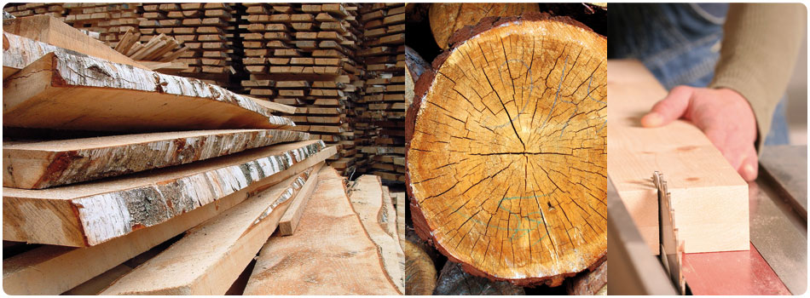
investments in industry
investments in energy
business zones
metal processing industry
wood industry
oil and gas
renewable energy
Maoče project
thermopower

Slide 12
INVESTMENTS IN
INDUSTRY

Slide 13
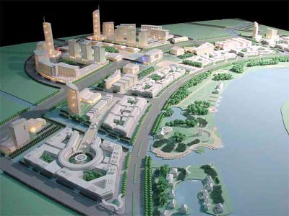
business zones
business zones are a form of entrepreneurial infrastructure which represents a developed area in construction terms, equipped with utility infrastructure, intended for a coordinated and planned use by a large number of companies and entrepreneurs, where the coordinated and planned approach enables a joint use of space, utility, administrative, financial, technical and other services, thus achieving lower operating costs.
at this moment in Montenegro we have defined business zones in 5 local municipalities, and also we are preparing few more, with emphasize on business zone in Podgorica
the beneficiaries of the zone may make use of incentives on the state and local level
1. program of state-level benefits:
employer who provides employment in the business zones shall be relief from paying contributions to mandatory social insurance until 31 december 2014
2. program of local government benefits:
incentives relating to payment of utility and other charges
good price od lease/purchase of land for the business zones
reducing tax rates on real estate
the possibility of defining a favorable model of public-private partnership
infrastructure equipment of the areas where this does not exist

Slide 14
metal processing industry
JSC ‘Institute for Ferrous Metallurgy’ Nikšić - conduct research and analysis in the field of technical engeenering: environmental testing and its protection, radioactivity measurement, training, physical security, chemical and metallographic analyzes, etc. The institute is also engaged in the production of castings and special alloy steel. Has significant assets in the real estate and capital equipment as well as human resources. The last four years doing business with a positive financial result with the constant increase in the rate of growth in total revenue and salaries. Institute currently employs 67 workers and is majority owned by the state, which has 51% equity.
JSC ‘Poliex’ Berane - the main production program of the factory made ​​powder, waterproof and ANFO explosives. The factory is also involved in delaboration mines while in 2011 introduced a new product, unique to the European market. Means labeled EGW (ecological gas wedge), and its purpose is splitting stone, concrete and marble effect with no changes to the environment that produces explosives. Ownership structure of Poliex make state with 46.4053%, Compensation Fund 4.3479% while the rest are smaller shareholders.
JSC ‘Electrodes Factory Piva’ Plužine - the basic activity of factory is the production of electrodes and welding wires. The goal is to find a strategic partner or buyer who will pull wide range of products that enable cost-effective production.

Slide 15
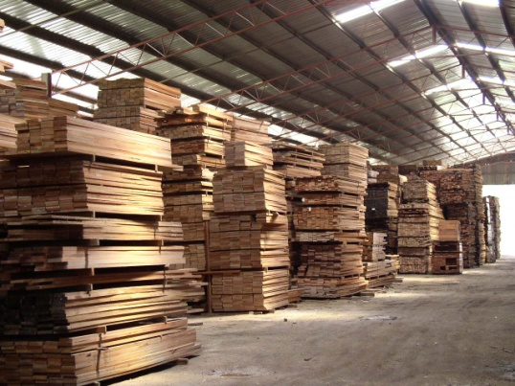
wood industry
around 300 companies are into wood industry and processing
most of these companies are located in north and north-east part of Montenegro
over 95% of companies are privately owned
significant capacities for production of wood elements, wooden parts, sawn wood are installed within all companies, which are privatized and whose new owners find it harder to modernize ("Vektra-Jakić"- Pljevlja; ŠIK "Lim" - Bijelo Polje; ŠIK "Polimlje" - Berane; "Boj komerc"- Andrijevica; ŠIP „Mojkovac“- Mojkovac; DIP „Donja brezna“- Plužine)
low utilization of existing capacity for the production of furniture ("Javorak" Niksic)
a relatively large number of small and medium privately owned companies has been established, of which: final production - 10% primary production - 90%

Slide 16
INVESTMENTS IN
ENERGY

Slide 17
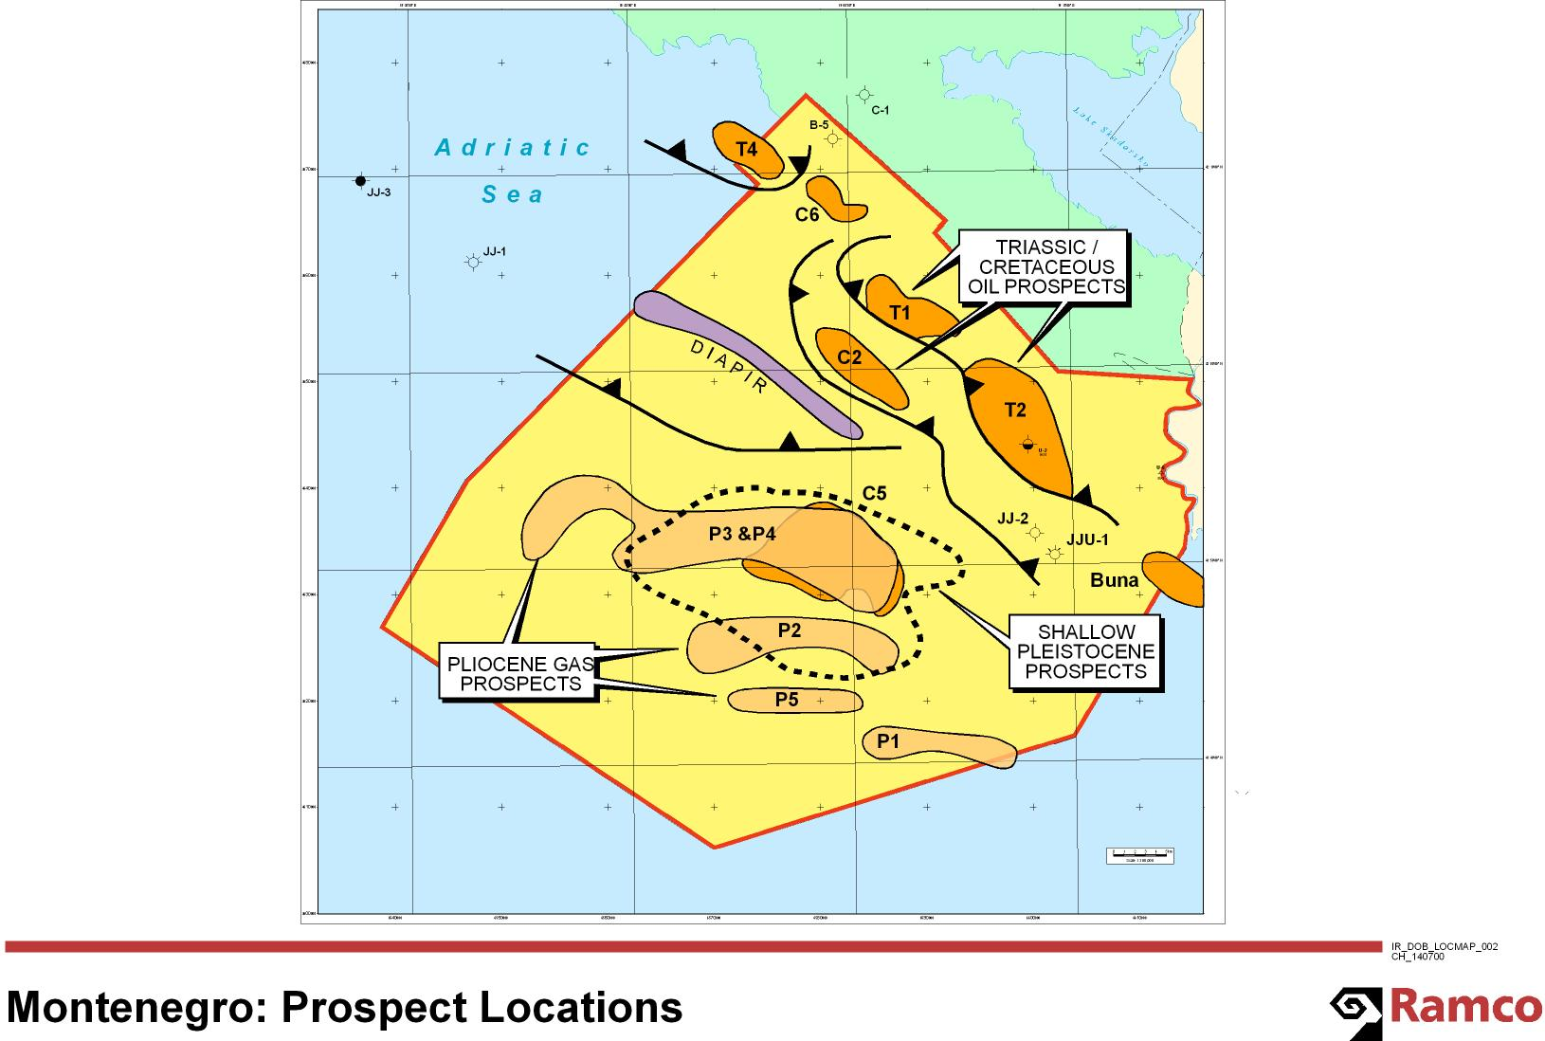
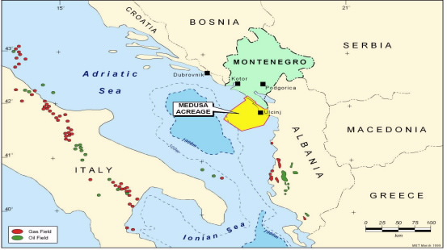
oil and gas
law envisages the possibility of getting two types of concession contract: Exploration Concession Contract and Production Concession Contract
the tender is planed for the first half of 2013
Concession System
the oil company has exclusive rights to the exploration and production at its own risk and cost;
the oil company owns the production;
the oil company pays fees and area rental fees to the Government;
the oil company pays taxes on profits;
the oil company owns the equipment;
the oil company has the right to export hydrocarbons;
the oil company has the right to equipment
www.petroleum.me

Slide 18
renewable energy
the most important renewable energy sources in Montenegro are:
hydropower
wind
biomass
sunlight
waste potential
new projects:
construction of small hydropower plants,
construction of wind power plants (total capacity of 70 MW);
construction of incinerators in mixed municipal solid waste (installed capacity of 10 MW);
construction of photovoltaic power plants and to other forms of biomass.
Montenegro is planing to adopt the Strategy of Energy Development 2030 and the Program of the development and use of renewable energy sources

Slide 19
renewable energy
Hydropower
Montenegro has a hydroelectric potential of about 10000 GWh / year along major rivers, while the gross hydropower potential of small rivers is estimated at about 800 ÷ 1000 GWh / year.
So far utilized about 17% of the total theoretical hydropower potential of Montenegro, which is about 11 000 GWh / year.
The total installed capacity of power plants in the power system of Montenegro is 868 MW, of which 76% in hydro, and 24% in TPP "Pljevlja" (TEP). The total projected annual net power is approximately 3,000 GWh

Slide 20
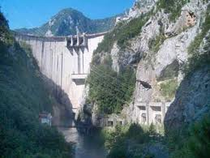
renewable energy
HPP Komarnica
possibilities for investment in two power generators of 168 MW, with annual production of 232 GWh (231,8 GWh)
total investment is around 182,8 mililon € in 6 years
activities:
adopted the draft of spatial plan
adopted the draft report of the Strategic Assessment
completed the fieldwork
Hydrological study was done
drafting of geological elaborate

Slide 21
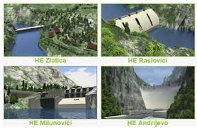
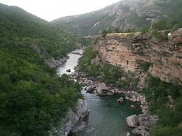
renewable energy
HPP Morača
basic Technical Design envisaging construction of four hydro-power plants with total installed power of 238.4 MW and average annual generated electric power of 721 GWh, with maximum level of the HPP Andrijevo reservoir at 285 meters ASL (above sea level) and reservoir accumulation of 250 hm³
activities:
EPCG is currently working on an analysis of the possibilities of the project realisation

Slide 22
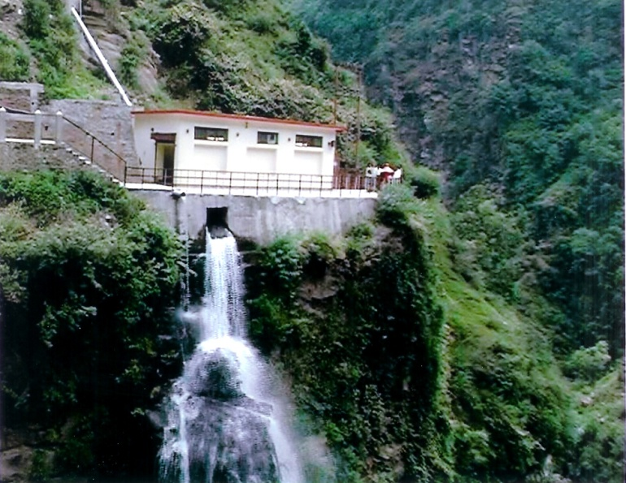
renewable energy
Small hydro power plants
over the past several years there have been more intensive activities on exploring the potential for the development of small hydro power plants (up to 15 MW). Under concluded concession agreements on the basis of two tenders, it is envisaged to construct 35 small hydro power plants with total power of around 100MW and total planned annual generation of around 300GWh
concessions were awarded for 25 mini hydro power plants and there are also some watercourses that are subject to concessions and they have not been awarded for them yet
there is also the possibility of granting concessions for the construction of small hydro installed capacity up to 1 MW of energy by introducing mechanisms of permits
Ministry of Economy plans to announce a new tender for the granting of concessions for the exploitation of small hydro in the 2013

Slide 23
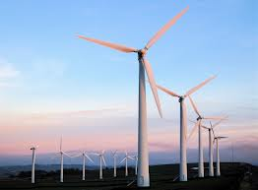
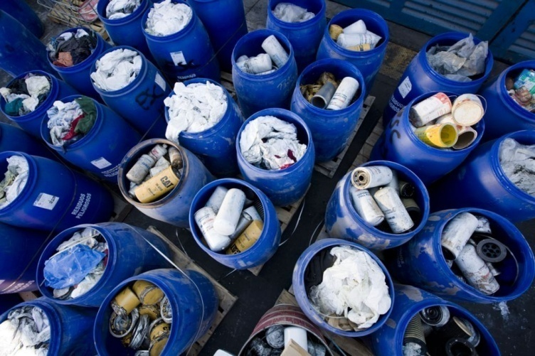
renewable energy
Windpower
Wind farm on the site Krnovo / VE Krnovo installed capacity of 72 MW
Wind farm on the site Možura / Možura wind power capacity to 46 MW
Solid waste management
Planning work:
Regional Landfill Construction in Niksic Municipality, for the Municipalities of Niksic, Savnik and Pluzine
Regional Landfill Construction for the Municipalities of Bijelo Polje, Kolašin and Mojkovac
Construction of the regional centre for waste management in Berane, for municipalities of Berane, Andrijevica, Plav and Rožaje
Construction of Regional centre for waste menagament in Kotor Municipality, for the Municipalities of Kotor, Tivat and Budva (Herceg Novi)
Construction of a Regional Landfill in the Municipality of Bar, for the Municipalities of Bar and Ulcinj

Slide 24
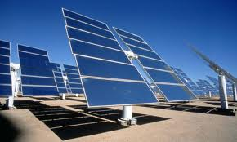
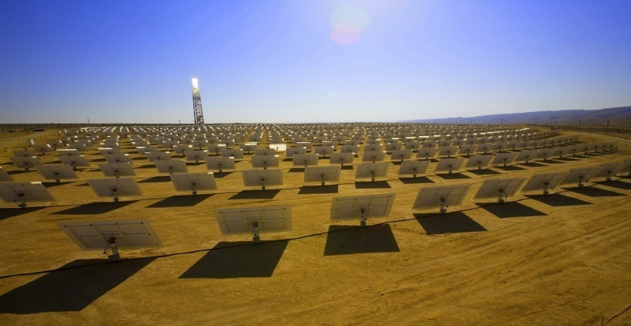
renewable energy
Solar energy
Montenegro has defined a framework for stimulating solar power plants. Incentive prices are offered in our legislation for solar panels installed on rooftops and constructions with the capacity up to 1MW. Given price is 15 c € / kWh.
Our legislative framework has not opened possibility for incentive price to be given to solar panels installed on the ground.

Slide 25
renewable energy
Incentive prices for electricity produced in plants using renewable energy sources c€/kWh
Tariff items for determining incentive prices for electricity produced in small hydropower plants

Slide 26
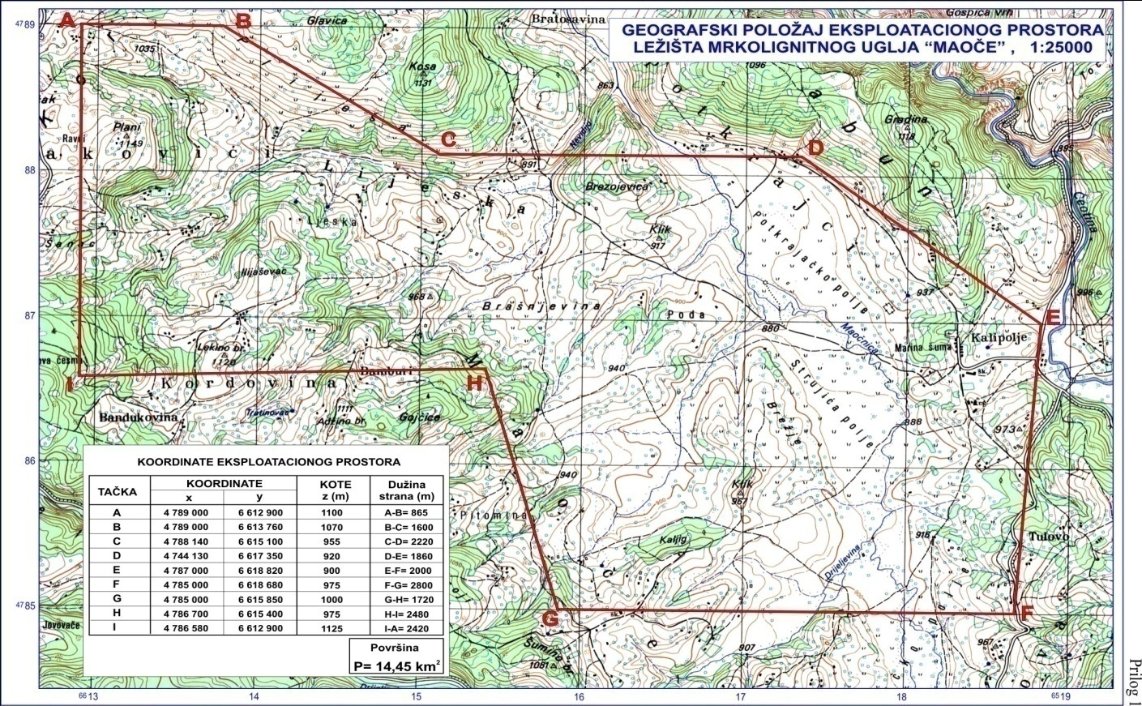
Maoče project
The Government of Montenegro will award a concession for the exploitation of coal from the basin of Maoče and the construction of a thermal power plant of the estimated capacity of 500 MW (2k250MW), based on the current reserves of coal and the thermal power plant life cycle;
The term of the concession contract is 45 years, with a possibility of extension in accordance with the law;
Concession fees for the exploitation of coal will be calculated as a percentage of revenues from the sales of electricity;
The proposed model of business operations is DBOMR (Design Build Operate Maintain Recultivate).
www.maoce.info

Slide 27
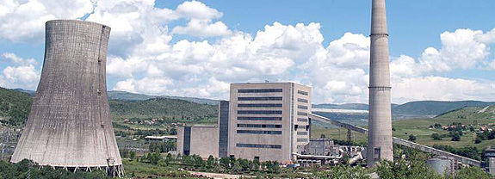
II Block of TPP Pljevlja
Government of Montenegro made the decision about the development of the master plan for the thermo power plant Pljevlja. This plan is the basis for the use of resources, sustainable development, conservation, protection and improvement of the thermo power plant.
Installation, infiltration, and the construction of new block is fully planned within the current block, with capacity of 110/220/40kV
Anticipated annual electricity production of both thermal power plant would be about 2,500GW/h

Slide 28
THANK YOU FOR
YOUR ATTENTION
WELCOME TO MONTENEGRO

