Slide 1
IFC Support to Infrastructure Projects
Per Kjellerhaug
Regional Manager,
Western Balkans
15 April, 2013 (Belgrade)
Notes:
1

Slide 2
IFC Overview
Notes:
2

Slide 3
IFC’s Three Businesses
IFC Investment Services
IFC Advisory Services
IFC Asset Management Company
Loans
Equity
Other forms of
financing
Advice
Problem solving
Training
Wholly-owned
subsidiary of IFC
Private equity fund
manager
Invests third-party
capital alongside
IFC
Notes:
3

Slide 4
Over $97 Billion Invested Since 1956
Largest multilateral source of loan/equity financing for the emerging markets private sector
Founded in 1956 with 182 member countries
AAA-rated by S&P and Moody’s
Equity, quasi-equity, loans, risk management and local currency products
Takes market risk with no sovereign guarantees
Promoter of environmental, social, and corporate governance standards
Resources and know-how of a global development bank with the flexibility of a merchant bank
Holds equity in over 722 companies worldwide, 184 of which are funds
IFC FY2012 Highlights
Portfolio | $31.4 billion
Committed | $15.5 billion
Mobilized | $4.9 billion
# of Companies | 1,737
# of Countries | 127

Slide 5
A Broad Range of Financial Products
Corporate Typically 5-15% shareholding Long-term investor, typically 6-8 year holding period Not just financial investor, adding to shareholder value Usually no seat on board
Subordinated loans Income participating loans Convertibles Other hybrid instruments
Senior Debt (reserve-based lending. corporate finance, project finance) Fixed/floating rates, US$, Euro and local currencies available Commercial rates, repayment tailored to project/company needs Long maturities: 7-12 years, appropriate grace periods Range of security packages suited to project/country Mobilization of funds from other lenders and investors, through financings, syndications (IFC “B” Loan structure), underwritings and guarantees
Equity
Mezzanine / Quasi-Equity
Senior Debts & Equivalents

Slide 6
Advisory Business Lines and Products
Access to Finance
Investment Climate
Public Private Partnerships
Sustainable Business
(financial institutions)
(governments)
(governments)
(real sector companies)
Microfinance
SME Banking
Credit Bureaus
Insurance
Leasing
Sustainable Energy Finance
Collateral Registries/Secured Transactions
Risk Management
Trade Finance
Housing Finance
Agribusiness Finance
Business Entry
Business Operations
Investment Policy & Promotion
Alternative Dispute Resolution
Business Taxation
Sub-National
Doing Business Reform Advisory
Trade Logistics
Public Private Dialogue
Assist national and municipal governments to implement private-sector participation projects in infrastructure, health and education.
Clean Energy
Resource Efficiency
EST Standards
SME & Farmer Capacity
Local Benefits Management
Corporate Governance
Sustainable Investing

Slide 7
Infrastructure & Natural Resources
Notes:
7

Slide 8
Investing Across Infrastructure & Natural Resources
Current portfolio: $9.2 bn
FY12 investments: $4.3 bn, including $2.1 bn in mobilizations
Local presence in key markets
Extended team covering both global giants and local leaders
Power |  | Utilities |  | Transport Infrastructure |  | Transport Services |  | Natural Resources |  | Telecom, Media, Tech
Generation, thermal and renewable Transmission Distribution Integrated Utilities |  | Water, Waste Privatized Public Services |  | Airports Ports Roads Railroads |  | Logistics Shipping Airlines Rolling Stock |  | Oil & Gas Gas Distribution Mining Pipelines LNG |  | Broadband Mobile Data Centers E-banking

Slide 9
Infrastructure and Natural Resources Globally
Infrastructure and Natural Resources Overview
Infrastructure Portfolio Breakdown by Departments –Outstanding Portfolio – June 2012
Globally, IFC’s Natural Resources and Infrastructure outstanding portfolio totals to US$9.2bn; 2% of IFC’s global portfolio. (As of June 2012)
The Latin American and Caribbean region represents Infrastructure & NR’s largest exposure at 29%, followed by Africa and Central and Eastern Europe, at 17%
Power represents the largest exposure, accounting for 33%, followed by Transport at 22%

Slide 10
Infrastructure and Natural Resources in EMENA
Infrastructure and Natural Resources Overview
EMENA Portfolio Breakdown by Departments –Outstanding Portfolio – June 2012
IFC’s Infrastructure commitment volumes averaged around US$2.7bn per year between 2008-2012.
In the EMENA region, IFC’s committed exposure is over US$3,9bn with an outstanding portfolio of US$2.8bn. Close to 19% of our portfolio is equity.
Turkey has the largest share in our outstanding portfolio with 17% share, followed by Russia (15%)
IFC is active in all infrastructure sectors in the region. Power and Transport are the largest exposures at 36% and 33% of our outstanding exposure.

Slide 11
IFC Deal Criteria for Infrastructure Projects
Sponsor • Strong sponsor, with a track record in sector
• Good reputation
• Financial strength and technical experience
• Long term commitment to success of the project
Project • Cost competitive in sector without considering an existing/ anticipated incentive structure with solid project fundamentals
• Experienced project development team
Financing • Solid equity contribution
• Sustainable debt: equity ratio
• Financing structure aligned with investment needs/project outlook
Technology • Technology leaders with tested technology
• Providing innovative solutions that improve the quality of products
Market • Existing or anticipated demand for product

Slide 12
Notable IFC Infrastructure Projects in the Balkans
Albania • $8.6 million in equity of Enso Hydro to develop a series of small hydro power plants
• €10 million loan to Credins Bank for renewable energy and energy efficiency projects.
Croatia • IFC provided a loan of €20 million and mobilized €35 million in syndications (total package EUR 55million) for the construction of the wind farm near Sibenik in Croatia with capacity totaling 43.7.MW.
Bulgaria • IFC provided a €46.1 million loan and mobilized the additional €41.1 million from UniCredit through the syndication loan, while OPIC provided a $50million in parallel loan for the 60 MWp Karadzhalavo solar power plant
• IFC provided a €40 million loan, working alongside the EBRD and Italy’s UniCredit, for the St Nikola wind farm.
Romania • IFC and EBRD have jointly lent €36.7 million each to Pestera Power and €57.4 million each to the Cernavoda I & II wind farms, with €50 million of the total raised through the syndicated loans.
Moldova • IFC provided a $3 million loan for development of four wind farms in the southern part of Moldova totaling a capacity of up to 350 MW.

Slide 13
The Balkans Renewable Energy and PPP Program
The Balkans Renewable Energy Program works to develop the renewable energy market in the Western Balkans countries.
IFC is working with banks and investors and actively looking for investment opportunities in the filed of infrastructure in Serbia, with a particular emphasis on renewable energy.
IFC also provides advice on designing and implementing public-private partnership (PPP) transactions to national and municipal governments.
2.2 billion

Slide 14
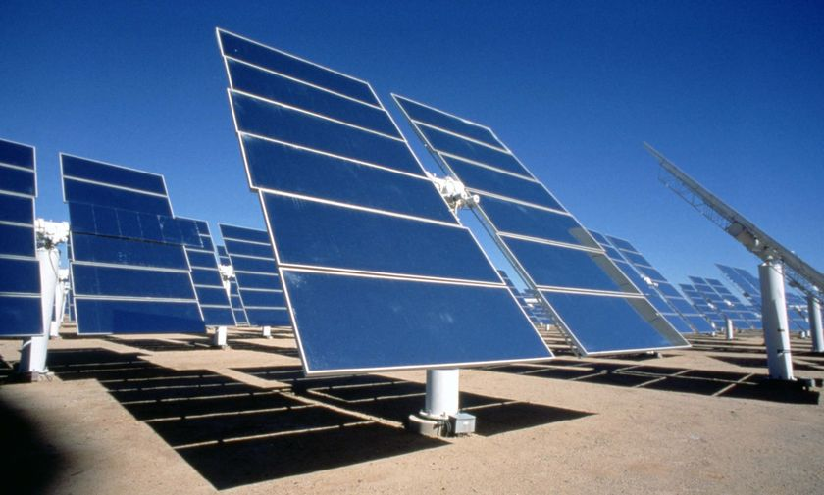
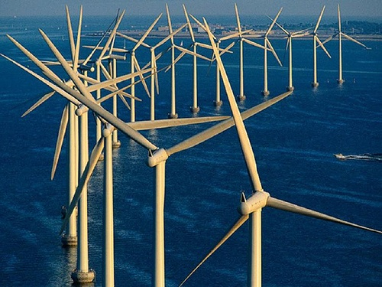
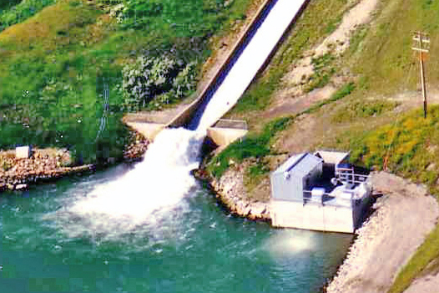
Power

Slide 15
IFC is a Leading Investor in Emerging Markets Power
200+ power investments in 57 countries since 1967
We typically invest in utility-scale projects/companies:
  Generation – Financed 26,000+ MW across wide range of technologies
  Transmission – Selected investments in transmission assets
  Distribution - Current power portfolio of ~160 million customers around the world
We can also invest in:
  Early stage start ups in the renewable energy space
  Smaller assets/companies through financial intermediaries (banks, PE funds)
We often invest in first-in-kind projects in markets under reform
We have expertise in climate-friendly investments; renewable generation was ~61% of the power business in FY 2012

Slide 16
IFC’s Global Power Portfolio
Global Power Portfolio Breakdown by Sectors – Outstanding Exposure (Loan + Equity): USD 3.3 billion (June 2012)
Over the last three years, IFC has put a strong emphasis on supporting renewable energy projects. 60% of IFC's commitments in the power sector were renewable energy projects
As more developing countries begin to create the enabling environments for supporting other forms of renewable energy, IFC is playing a key catalytic role
* source: REN21 (2012 report)

Slide 17
IFC Has Strong and Differing Role in Supporting Each Renewable Technology
Hydro
Wind
Biomass
Solar
Geo
EE
Established and cost competitive technology
Large hydros have long development time
Dams offer base-load
Potential for local E&S issues
Established technology
Economics very site specific
Variable generation
Dependent on suitable regulatory support
Technology risk varies with fuel type
Long-term access to low cost fuel essential
Opportunities for co-firing and co-generation
PV still expensive but costs declining quickly
CSP w/ storage offers potential for low cost base load
Potential for grid and distributed generation
Established and cost competitive baseload technology
High exploration risks and long lead times to develop steam fields
Profitable opportunities exist in generation, T&D and end use
Opportunities can be diffuse and require identification and aggregation
Characteristics
Taking construction risk
Providing long-tenors to match asset life
Innovative bundling for small hydros
Ensuring best practice E&S
Supporting (i) projects in new markets & new regulations; (ii) supply chain expansion to reduce costs
Structuring to support intermittent generation & merchant risk
Structuring fuel supply agreements to enable project finance
Understanding technology risk
Supporting supply chain expansion to reduce costs
Supporting projects in new markets and new regulatory regimes
Coordinating concessionary funding to buy down costs
Early stage equity and concessionary funding to share exploration risk
Sector expertise and innovative structuring to enable project financing
Identifying and incorporating EE opportunities in all projects
Coordinating concessionary support to identify and package opportunities for clients
IFC Role & Comp. Adv

Slide 18



Akenerji
Project Description
Owned jointly by Akkok Group of Turkey and CEZ Group of Czech Republic
570 MW of generation capacity as of December 2010
Project consists of five small scale hydropower projects (Feke I – 30MW, Feke II – 70MW and Himmetli and Gokkaya – 27MW and 30MW respectively in Adana)
Closing Date: June 2010
Financing Aspects
Tranche | Product | Amount | Tenor
IFC A Loan | Senior Debt | US$65 million | 8 years
IFC C Loan | Subordinated Loan | US$10million | 8 years
Notes:
18

Slide 19








Selected Investments in Power in EMENA
Bulgaria
Turkey
Turkey
Turkey
AES Kavarna
Enerjisa
SEDAS
Akenerji
$58,000,000
Loan
Financing
EUR513,000,000
Loan Financing
$ 150,000,000
Loan Financing
$75,000,000
Loan Financing
Lender
August 2008
Mandated Lead
Arranger
June 2008
Mandated
Lead Arranger
December 2010
Lender
June 2010
Hungary
Ukraine
Ukraine
Macedonia
ESCO Hungary
AESKyivOblenegro
AES RivneEnergo
ESM Macedonia
$3,000,000
Loan Project
Financing
$30,000,000
Loan Project
Financing
$15,000,000
Loan Project
Financing
$55,330,000
Loan Project
Financing
Lender
November 1999
Lender
June 2005
Lender
June 2005
Lender
April 2008
Russia
Turkey
Poland
Tajikistan
Mosenergo
ENTEK
ESCO Polska
Pamir
$20,000,000
Loan Project
Financing
EUR51,500,000
Loan Financing
$2,000,000
Loan Project
Financing
$8,000,000
Equity and Loan
Financing
Lender and Shareholder
September 2002
Lender
June 1998
Lender
May 1998
Lender
September 1999

Slide 20













Diverse Clients Trust IFC as a Power Sector Partner
Half our business is with global clients
  We have forged long-term partnerships with key clients
  Recent trend of partnering with renewable energy companies expanding into emerging markets
We support local clients to become global clients
  Local power companies investing in their own country or expanding into other emerging markets
  Local industrials expanding into the power sector
  Our local clients are becoming a larger share of our business as market reform increases opportunities for private investment in the power sector
We work with emerging renewable energy companies
  We have supported newly started local renewable energy firms, as they begin to build their first projects

Slide 21





Telecoms Media & Technology

Slide 22
IFC’s TMT Portfolio in the EMENA Region
Global TMT Portfolio Breakdown by Sectors – Outstanding Exposure (Loan + Equity): USD 1.3 billion (as of June 2012)
EMENA TMT Portfolio Breakdown by Sectors – Outstanding Exposure (Loan + Equity): USD 276 million (as of June 2012)

Slide 23
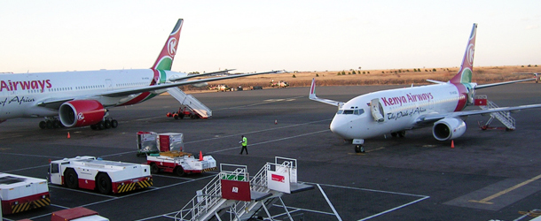
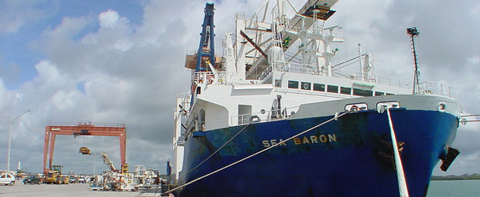
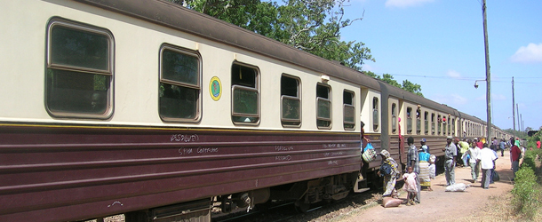
Transport

Slide 24
IFC’s Transport Portfolio in the EMENA Region
Global Transport Portfolio Breakdown by Sectors – Outstanding Exposure (Loan + Equity): USD 1.9 billion (as of June 2012)
EMENA Transport Portfolio Breakdown by Sectors – Outstanding Exposure (Loan + Equity): USD 914 million (as of June 2012)

Slide 25

Arkas – Container Operations
Project Description
The project is to provide a corporate loan of US$45 million to Arkas Holding A/S (“Arkas”, or the “Group”), which is one of Turkey’s leading maritime transport and logistic groups.
Arkas’ primary focus is on container operations. It has its own container shipping line, operates its own container port terminals, and its shipping agency accounted for 40% of the containers moving through Turkey in 2007.
The purpose of the corporate loan is to provide Arkas with the financial flexibility to proceed with a number of opportunities with which it is currently presented, primarily the development of several ports under Turkey’s ports privatization program.
Closing: September 2007
Financing Aspects
Tranche | Product | Amount | Tenor
IFC | Senior Debt | US$45 million | 9 years

Slide 26





Transport Investments in EMENA
Georgia
Turkey
Argentina
Turkey
TAV Georgia
TCE Ege
Arkas Group
$27,000,000
Senior Loan
$20,000,000
Senior Loan
$45,000,000
Senior Loan
Lender
May 2006
Lender
June 2010
Lender
September 2007
Egypt
Romania
Jordan
DP World Sokhna
Arabesque
Queen Alia airport
$20,000,000
Senior Loan
EUR56,000,000
Senior Loan
$280,000,000
Syndicated Loan + Quasi equity
Lender
April 2004
Mandated Lead Arranger
June 2007
Mandated Lead Arranger
November 2007

Slide 27
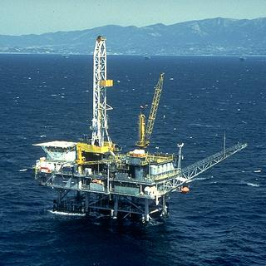
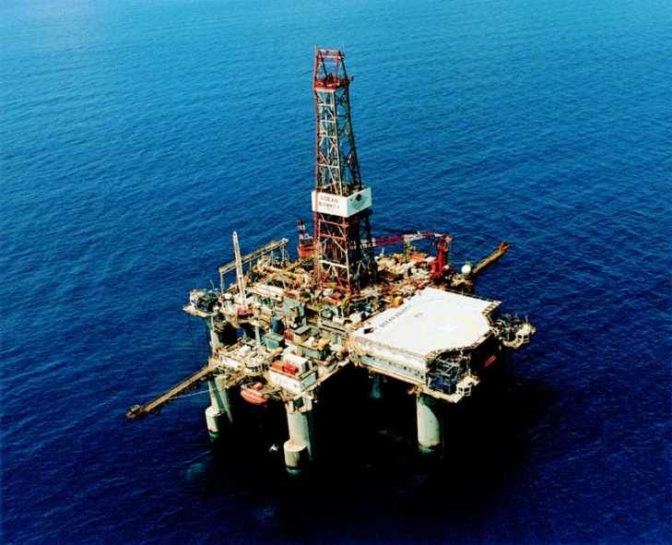
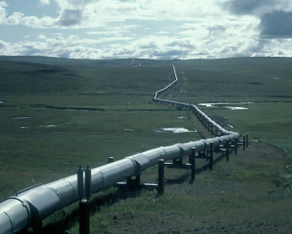
Mining, Oil & Gas

Slide 28





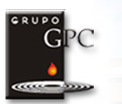










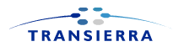



Global Expertise, Selected Transactions
Venezuela
Kazakhstan
Russia
Turkey/Romania
BTC Pipeline
Colombia
Tunisia
Yemen/Vietnam
Egypt/Bulgaria
Asia
Peru
Colombia
Pakistan
Ghana
Peru
Argentina/Chile
Chad/Cameroon
ENH
Mozambique
India
Oman
Bolivia/Brazil
Argentina
Nigeria/Sao Tome
Pakistan/Egypt
India
Notes:
28

Slide 29

Izgaz
Project Description
Privatization of gas distribution in the city of Izmit awarded to GdF SUEZ in 2009.
Mid-sized gas distribution company in Turkey with 180,000 customers, 297 employees and 2,525 km of distribution pipes.
One of the leading energy providers in the world, GdF SUEZ achieved revenues of €83.1 billion in 2008.
IFC’s first local currency financing in Turkey
Total project cost: EUR556 million
Closing: June 2009
Financing Aspects
Tranche | Product | Amount | Tenor
IFC | Senior Debt | USD50 million | 9 years
European Bank for Reconstruction and Development | Senior Debt | USD60 million | 9 years

Slide 30
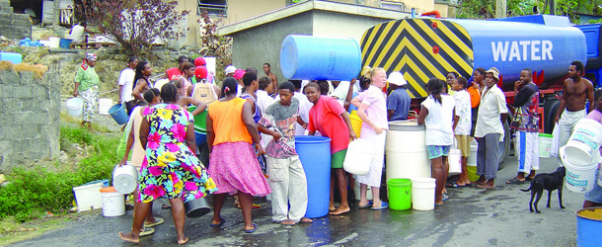
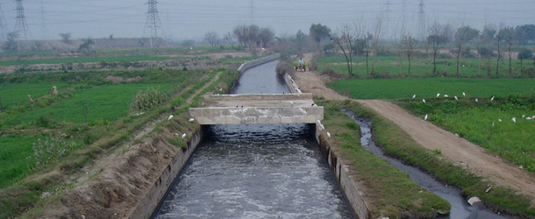
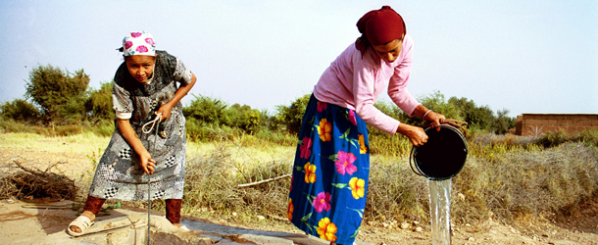
Water & Utilities

Slide 31
IFC’s Utilities and Water Portfolio in the EMENA Region
Global Utilities Portfolio Breakdown by Sectors – Outstanding Exposure (Loan + Equity): USD 459 million (as of June 2012)
EMENA Utilities Portfolio Breakdown by Sectors – Outstanding Exposure (Loan + Equity): USD 211 million (as of June 2012)

Slide 32
Contact
Per Kjellerhaug, IFC
Regional Manager, Western Balkans
Bulevar Kralja Aleksandra 86
11000 Belgrade
Tel: +381 11 3023 750
Email: Pkjellerhaug@ifc.org

Slide 33
Thank You
Notes:
33

