Slide 1

CURRENT STATUS AND NEW INVESTMENTS OF THE ELECTRIC POWER INDUSTRY OF SERBIA
PE ELECTRIC POWER INDUSTRY OF SERBIA
Dusan Zivkovic, Head of Investment EPS
April, 2013

Slide 2
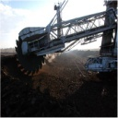
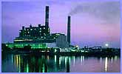
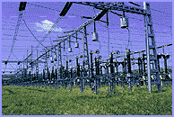
EPS - Structure, Ownership & Activities
Structure
    Vertically organized company
Ownership
    100% owned by the Republic of Serbia
Activities
    Electricity generation
    Distribution and distribution system operation
    Electricity trading
    Coal production, processing and transport
    Steam and hot water generation in combined processes
www.eps.rs
2
Notes:
2

Slide 3
EPS - Overview
Installed Capacities
Hydro Power Plants 2,835 MW
Thermal Power Plants 5,171MW 3936 MW*
Combined CH Plants 353 MW
Total 8,359 MW 7124MW*
Production
Production 36,050 GWh
Production with K&M 41,284 GWh
Coal Production* 40.2 milt
Gross Consumption* 34,450 GWh
Number of Customers* 3.5 million
* Excluding K&M
As of June 1999, EPS cannot manage its facilities on the territory of Kosovo and Metohija (K&M)
www.eps.rs
3

Slide 4
EPS – Installed Capacities
www.eps.rs
4
Notes:
4

Slide 5



EPS Goals
    Safe and secure supply of all customers
    Building new generation capacities
    Increasing of RE in EPS genaration
    Increasing of energy efficiency
    Reduction of GHG emission
    Sustainable development of the company
Notes:
5

Slide 6
Production & Consumption up to 2020
  In the period 2010-2020, EPS forecast indicates up to 13% increase in overall consumption
www.eps.rs
6
Notes:
6

Slide 7
EPS Investment activities from 2002 - 2012

Slide 8
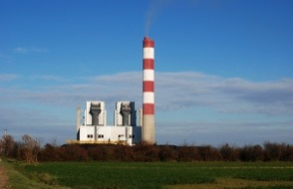
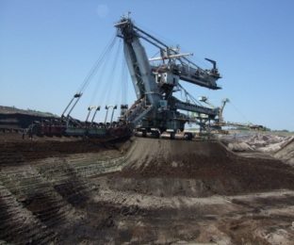
EPS Investment activities from 2002 - 2012
  From 2002 - 2012 EPS invest over € 4 billion
  Generation capacity and mining
  Enviromental protection
  From 2002 - 2005
  Average investments are € 248 mio per year
  From 2006 - 2012. EPS invest over € 3 billion
  Average investments are € 450 mio per year

Slide 9
Most important projects in EPS up to 2012
 | mio €
Rehabilitation TPP TENT units А4, А5, А6 | 241
Reconstruction of distribution network – 110,35,20,10,0,4 kV | 242
Reconstruction of ash disposal system on the TPP TENT B and TPP Kostolac A , B | 85
II BTO system in Tamnava West | 78
Rehabilitation of HPP Djerdap | 68
V BTO system in Drmno | 62
Developement of telecommunication network | 45
Rehabilitation of HPP Bajina Basta | 60
Electrostatic percepitators in TPP ТЕНТ А1, А2, А4, А5; TPP Костолац А1, А2 | 31
Rehabilitation TPP Kostolac, unit B2 | 30
Smart metering | 10

Slide 10
Most important projects in EPS from 2012
 | Mio € | Financing source
FGD on TENT А3, A4, A5,A6; TENT B1, B2; TPP Kostolac B1, B2 | 503 | jica loan China loan
Reconstruction of distribution network – 110 kV | 90 | -
Smart metering | 80 | EIB&EBRD
BTO system, spreader and coal management system in CM Kolubara | 140 | EBRD /KfW
RE projects – SHPP | 120 | EBRD (I faze €45 mio)
Rehabilitation of HPP Zvornik | 70 | KfW
Rehabilitation of TPP Kostolac B1 | 84 | China loan
NOx emision reduction on TPP TENTА3-6; TPP TENT B1, B2 TPP Kostolac B1, B2 | 60 | IPA IPA China loan
Reconstruction of ash disposal system on the TPP TENT А | 50 | KfW
Electrostatic percipitators on TPP TENT A3,A6; TPP TENT B1, B2, TPP Kostolac B1, B2 | 49 | IPA IPA China loan

Slide 11
Investments in new genaration in EPS
 | Mio €
TPP Kolubara B | 1.300
5 HPP on Morava river | 360
10 HPP on Ibar river | 290
TPP TENT B3 | 1.600
OCM Radljevo | 700
PSPP Bistrica | 553
3 HPP on midle Drina | 410
PSPP Djerdap 3 | 400 (I фаза)
CHPP Novi Sad | 320
4 HPP on upper Drina | 217

Slide 12
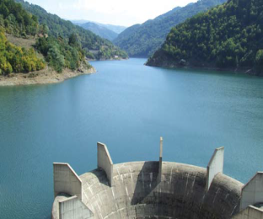
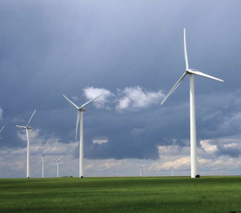
Investments in RE in EPS
The RS Government has introduced a "feed-in" tariffs
Rehabilitation of existing SHPP that are in operation in EPS 15 SHPP – I faze
Development of new SHPP 8 SHPP – I faze
Wind farm on location Kostolac WF 30 MW (~ €45 mio)
Investigation for solar PP locations Čajetina 5 MW Kostolac 5 MW
Investigation for waste to energy and biomass to energy PP loactions

Slide 13
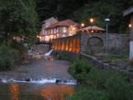
Rehabilitation of SHPP owned by EPS
EBRD Loan for rehabilitation of 15 SHPP
Installed power | 23,15 MW
Generation capacity | 77 GWh
Investment | € 23 mio
SHPP Ovčar Banja | SHPP Moravica
SHPP Medjuvršje | SHPP Sveta Petka
SHPP Radaljska reka | SHPP Sićevo
SHPP Vrelo | SHPP Temac
SHPP Raška | SHPP Sokolovica
SHPP Seljšnica | SHPP Gamzigrad
SHPP Turica | SHPP Vučje
SHPP Kratovska Reka | SHPP Jelašnica
9. SHPP Pod Gradom

Slide 14
SHPP on existing water supply acumulations
SHPP on existing water supply acumulations that could used for energy generation
SHPP Ćelije | SHPP Svračkovo is not part of EBRD loan Installed power of all other 14,31 MW Generation capacity ~56 GWh Investment € 19 mio
SHPP Bovan
SHPP Barje
SHPP Zlatibor
SHPP Parmenac
SHPP Rovni
SHPP Selova
SHPP Svračkovo
SHPP Vrutci

Slide 15
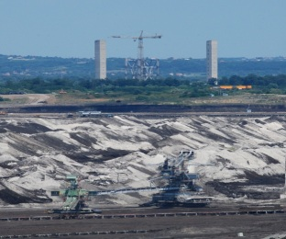
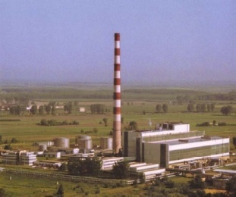
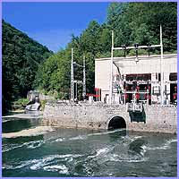
Conclusions
  Implementation of the planned investment for development and construction of new facilities will enable EPS
  Continuous and stable operation
  Reliable supply of electricity to customers in terms of expected growth needs
  Activ role in regional and European energy market
  Busines development and economic growth

Slide 16
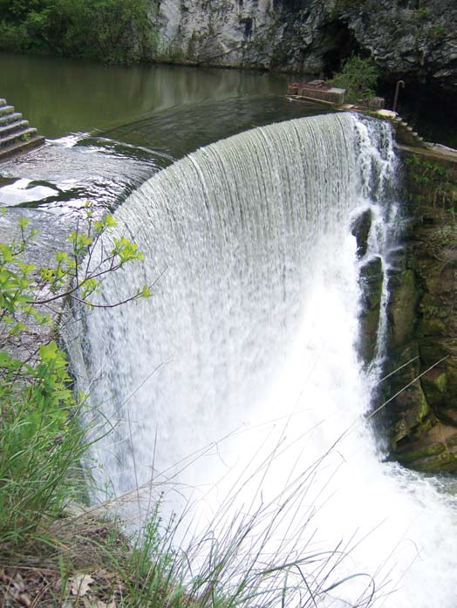
THANK YOU
PE ELECTRIC POWER INDUSTRY OF SERBIA
Balkanska St. № 13, 11000 Belgrade, Serbia
Phone: +381 11 3610580
www.eps.rs
16

