Slide 1
Electricity and Natural Gas Markets in Serbia
Ljiljana Hadzibabic
Council member
Energy Agency of the Republic of Serbia
Belgrade,
15. April 2013.

Slide 2
Content
Markets Types and Market Participants
The Dynamics of the Market Openning
Electricity and Natural Gas Market Models in Serbia
The legal framework for the functioning of the Markets
Comparative Electricity and Gas Prices for the industry in some EU countries

Slide 3
Markets Types
Electricity | Natural Gas
Bilateral | Bilateral
Balancing Market | -
Exchange | -

Slide 4
Market Participants
Electricity | Natural Gas
Producers | Producers
Suppliers | Suppliers
Public Suppliers (1) | Public Suppliers (34)
 | Suplier of Public Supliers (temporarily, on their request)
The final buyer | The final buyer
Transmission System Operator | Transmission System Operator
Distribution System Operator | Distribution System Operator
 | Underground Storage Operator
Market Operator
Balancing responsibilities of all market participants;
Relations of Market participants are regulated by agreements.

Slide 5
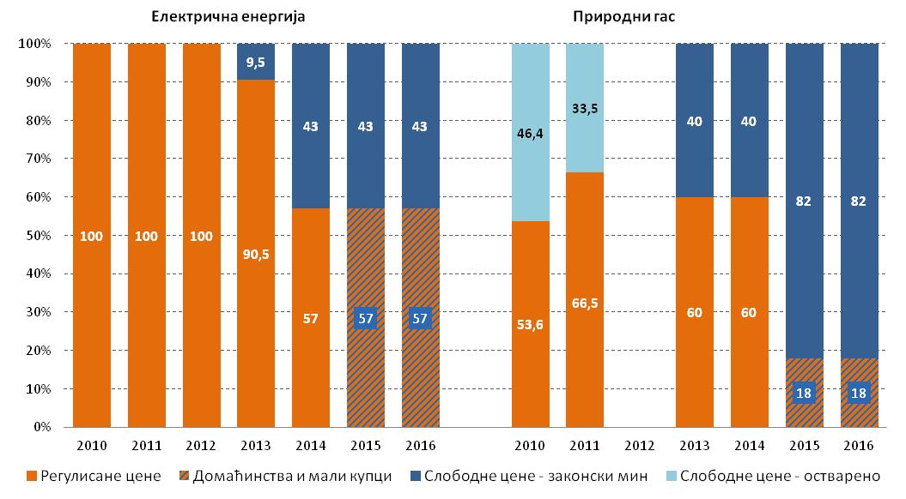
The Dynamics of the Market Opening
Electricity Natural Gas
Market Opening - realized and planned
The markets will be 100% be open from 1 Jan 2015,
but the households and small consumers may choose from the market or the public supply

Slide 6
Electricity Market Model

Slide 7
Natural Gas Market Model

Slide 8
The Legal Framework for the Market Functioning
Electricity | Natural Gas
EU directives - mandatory baseline
The Energy Law
Transmission and Distribution Grid Codes |  | Transmission Grid Code (2) (including the rules for the capacity allocation elements of Market Code) and Distribution Grid Codes (34)
Rules governing the allocation of rights to use cross-border transmission capacities
Market Code
Rules about supplier changing
Methodologies for the determination of the price for access to electricity transmission and distribution system |  | Methodologies for the determination of the price for access to electricity transmission and distribution system

Slide 9
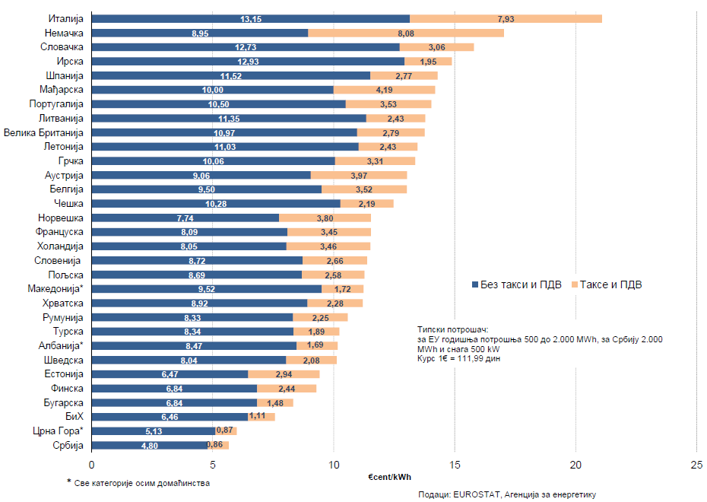
Comparasion of the Electricity Prices for the Industry - The first half of 2012 -

Slide 10
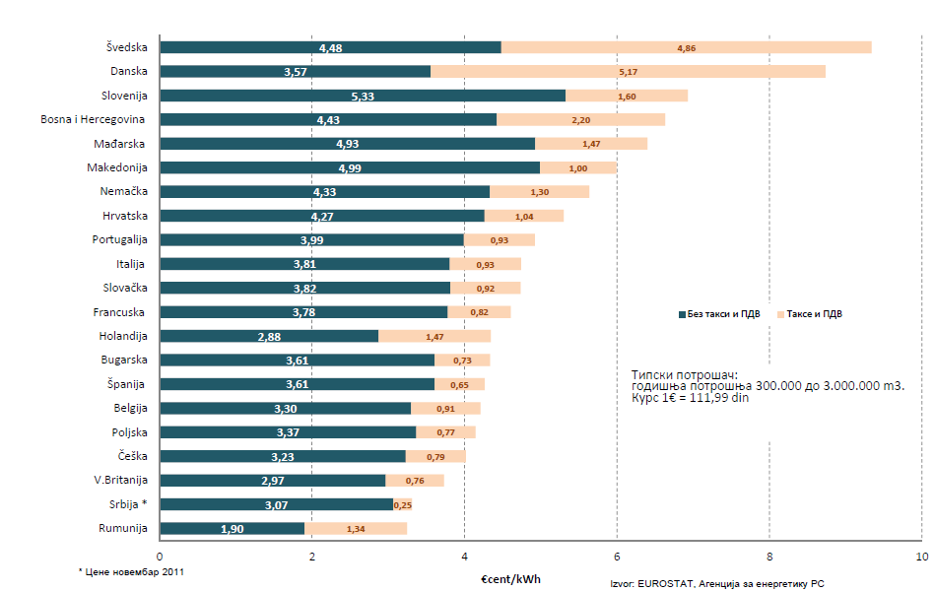
Comparasion of the Natural Gas for the Industry - The first half of 2012 -

Slide 11
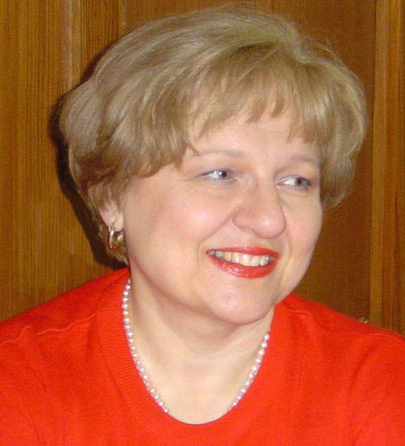
Thank you for your attention!
Ljiljana Hadzibabic
Council member
Energy Agency of the Republic of Serbia
www.aers.rs

